Slide 1
Annual 3G Ozark Meeting
July 2014

Slide 2
Agenda
TFF Update Jean
NGAB Update Megan
NG and MG Review/Voting Teresa
2014 YPC Conference Recap Mike, Megan
Tracy Family Outreach Ellie, Kristin
Alzheimer’s Walk Kristin
Notes:
Jean – 5 min
Megan – 10 min
Teresa – 30 min
Ellie/Kristin – 15 min

Slide 3
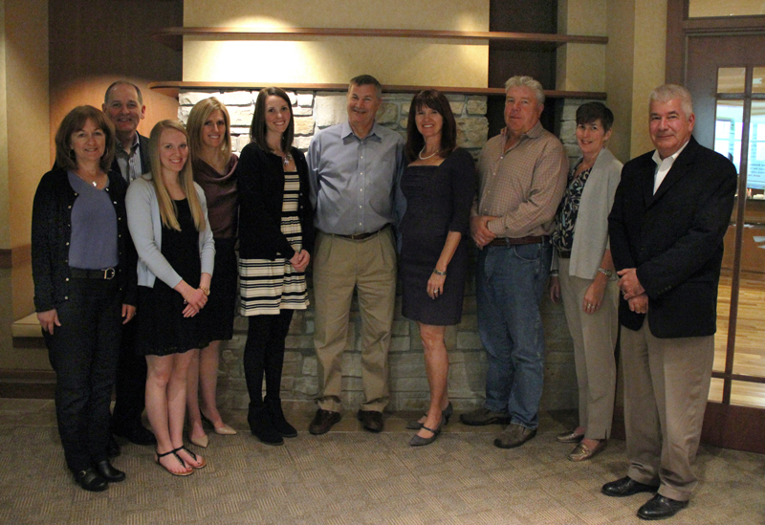
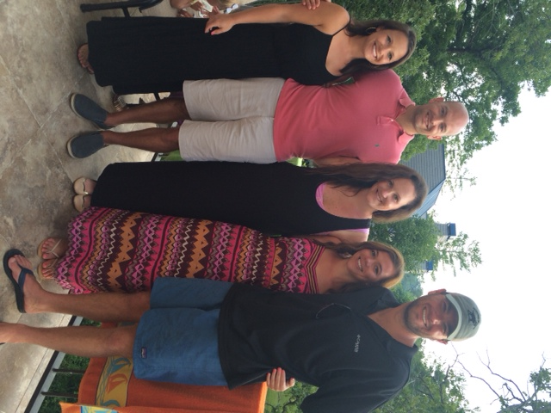
TFF Board & TFF Next Gen Advisory Board
Hmm…3 of 10 are 3Gs…Are we taking over?!!!
We love being on the Next Gen Board!
We are saving the world!

Slide 4
2014 TFF Committees
Committee | Members
BC Teacher Fund | Jean (Chair) Jane Tracy, Mary Sullivan, Angie Tracy
Catholic School Education | Pat (Chair), Jane T, Susan, Elizabeth Brown, Jean Johnson, Ray Heilmann, Father Tom Meyer, & Jean
Catholic School Grants | Susan Stamerjohn (Chair), Jane Schmidt, Jean, & Mom
Compensation | Smitty (Chair), Mary, & Rob
Economic Development | Jim (Chair), Fred, Susie, David Slocum, David Knight, & Jean
Education | Jean (Chair), Linda. Tom, Angie, and Liz
Investment | Mugs (Chair), Joe, Mike, Matt H, Bill M, Tom, Rob, Lauren, Jean, Chris Stamerjohn, & Brian Buckley
Leadership | Jane Tracy (Chair), Mike Tracy, Anne, John O, Wanda, & Erin
Tracy Family Outreach | Susan Stamerjohn (Chair), Linda, Kristin, Ellie, & Nikki
Youth & Family | Don Tracy (Chair), Smitty, Christie Mugerditchian, Erica Briscoe, & Jean
3G Ozark | Mike Tracy & Teresa Sullivan (Co-Chairs), Kelsey
4G Book | Linda (Chair), Mary, Kelsey, & Christine 3G Mom Advisors: Amelia, Erin, Katy, and Sara
Notes:
New Committee: Catholic School Grant Committee

Slide 5
2013-17
Long Range Strategic Plan
Tracy Family Foundation
2013-17 Focus Areas
EDUCATION Brown County and Region
YOUTH AND FAMILIES Brown County and the Region
LEADERSHIP Brown County and the Region
ECONOMIC DEVELOPMENT Brown County Only

Slide 6
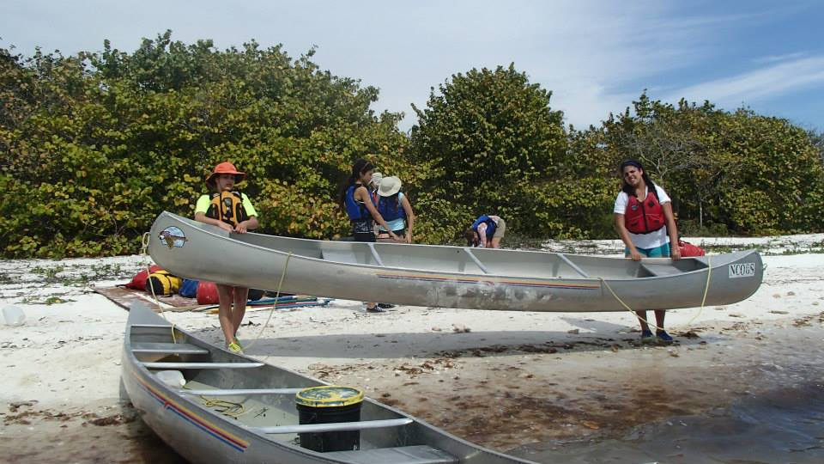
FOCUS AREA - LEADERSHIP
Outward Bound, North Carolina

Slide 7
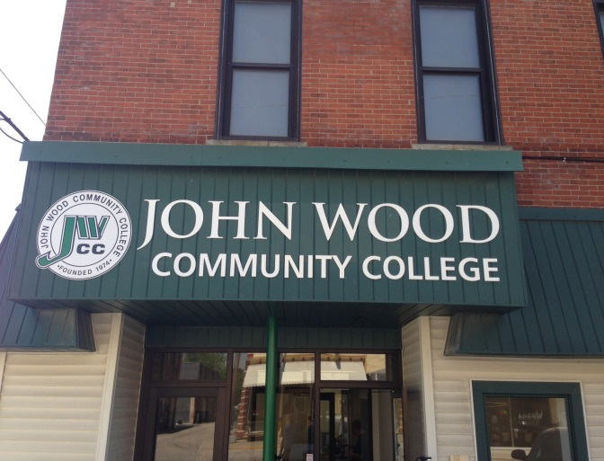
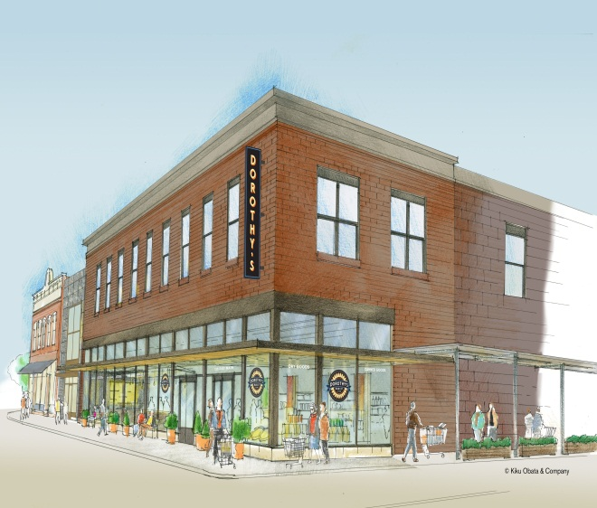
FOCUS AREA
Economic Development in Brown County

Slide 8
Our Growing Numbers
  Third Generation
    54 3Gs (47 3G descendants and 7 3G in-laws)
      30 years of age and older – 14
      Out of College Age – 21
      In College Age – 8
      High School – 4
      Grade School – 7
  Fourth Generation
    7 4Gs
      3 months to 3 years old

Slide 9
NGAB Update
Mission Statement: The Next Generation Advisory Board exists to cultivate an understanding of philanthropy and build leadership skills in the next generations. The board will actively listen to all generations offering opportunities, education and support to fulfill the Tracy Family Foundation’s vision for the family.
Members: Megan (Chair), Kelsey (Vice Chair), Christine (Secretary), Eric and Luke
Special Impact Grant
  StL Crisis Nursery Center – July site visit
  3-4 current organizations
4G ABC Picture Book

Slide 10
NG and MG Review/Voting

Slide 11
Name of the Organization
Who they help?
What do they do?
Where does your money go?

Slide 12
3G Next Generation Grants
Adams/Pike Regional Office of Education - Kristin, Sam, Ali, and LIv Tracy
Bay Area Vineyard Church – Amelia George
Boston College Campus School - Teresa Sullivan
Camp of Dreams – Liz Tracy
First Baptist Church of Quincy - Ellie Stamerjohn
Good Friends, Inc. - Angie Tracy
Midnight Run, Inc. - Maggie Sullivan
Quincy Catholic Elementary School Foundation - Megan Buckley
Saint Louis University Global Brigades - Micaela Tracy
Youth in Need - Nikki and Mike Tracy

Slide 13
3G Matching Grants
Andrew Deuel – Red Cross, Washington DC
Angie Tracy – Athletes for Autism, Milwaukee WI
Chris, Drew, and Luke Stamerjohn – QND Foundation
Lauren Tracy – St. Louis Crisis Nursery, St. Louis MO
Megan Buckley – Dining for Women, Greenville SC

Slide 14
2014 YPC Recap
Attendees: Linda, Mike & Megan
Mike served on Leadership Planning Committee
Linda & Megan: co-facilitated a panel re: NextGen Transitions
Ideas for the Future:
  dosomething.org
  Connect with other family foundations in St. Louis area
  Invite a speaker to next TFF Retreat
  Mission/service trip

Slide 15
Tracy Family Outreach
Committee organized to plan first family volunteer activity at the Ozarks
Share the Harvest
  A food pantry and public garden that helps to feed the poor
Thursday, August 7th from 10 am – 12 pm
  15 – 20 volunteers to work inside pantry and outside in the garden
  Bring some can goods from your pantry in your cabin

Slide 16


WALK TO END ALZHEIMER’S
Fall 2014 Dates & Locations
Quincy, IL → 9/4
St. Louis, MO → 9/6
Springfield, IL → 9/20
San Francisco, CA → 9/20
Denver, CO → 9/20
Colorado Springs, CO → 9/20
Springdale, AR → 9/20
Newport, RI → 9/21
Camdenton, MO → 9/27
Chicago, IL → 9/28
San Antonio, TX → 9/20
New Haven, CT → 9/28
Boston, MA → 9/28
Duluth, MN → 10/4
Milwaukee, WI → 10/4
Kansas City, MO → 10/5
Indianapolis, IN → 10/12
New York, NY → 10/19
Tucson, AZ → 11/1
Naples, FL→ 11/15

