Slide 1
Annual Next Gen Ozark Meeting
July 2, 2018
Notes:
Presenter: Nikki

Slide 2
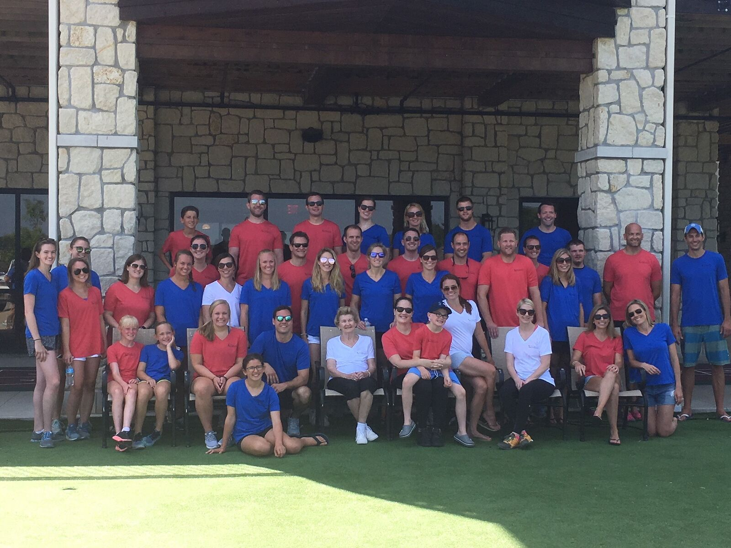
Agenda
4G Breakout Activity
TFF Update
NGAB Update
Volunteer Activity
New TFF Projects
Next Gen & Matching Grant Review/Voting
3G/4G Group Photo
Notes:
Presenter: Nikki

Slide 3
4G Breakout Activity
All 4Gs dismissed to the Boardroom for
story-time and an art project.
Notes:
Presenter: Nikki

Slide 4
Tracy Family Foundation
ANNUAL NEXT GEN OZARK MEETING
July 2, 2018
Notes:
Presenter: Jean

Slide 5
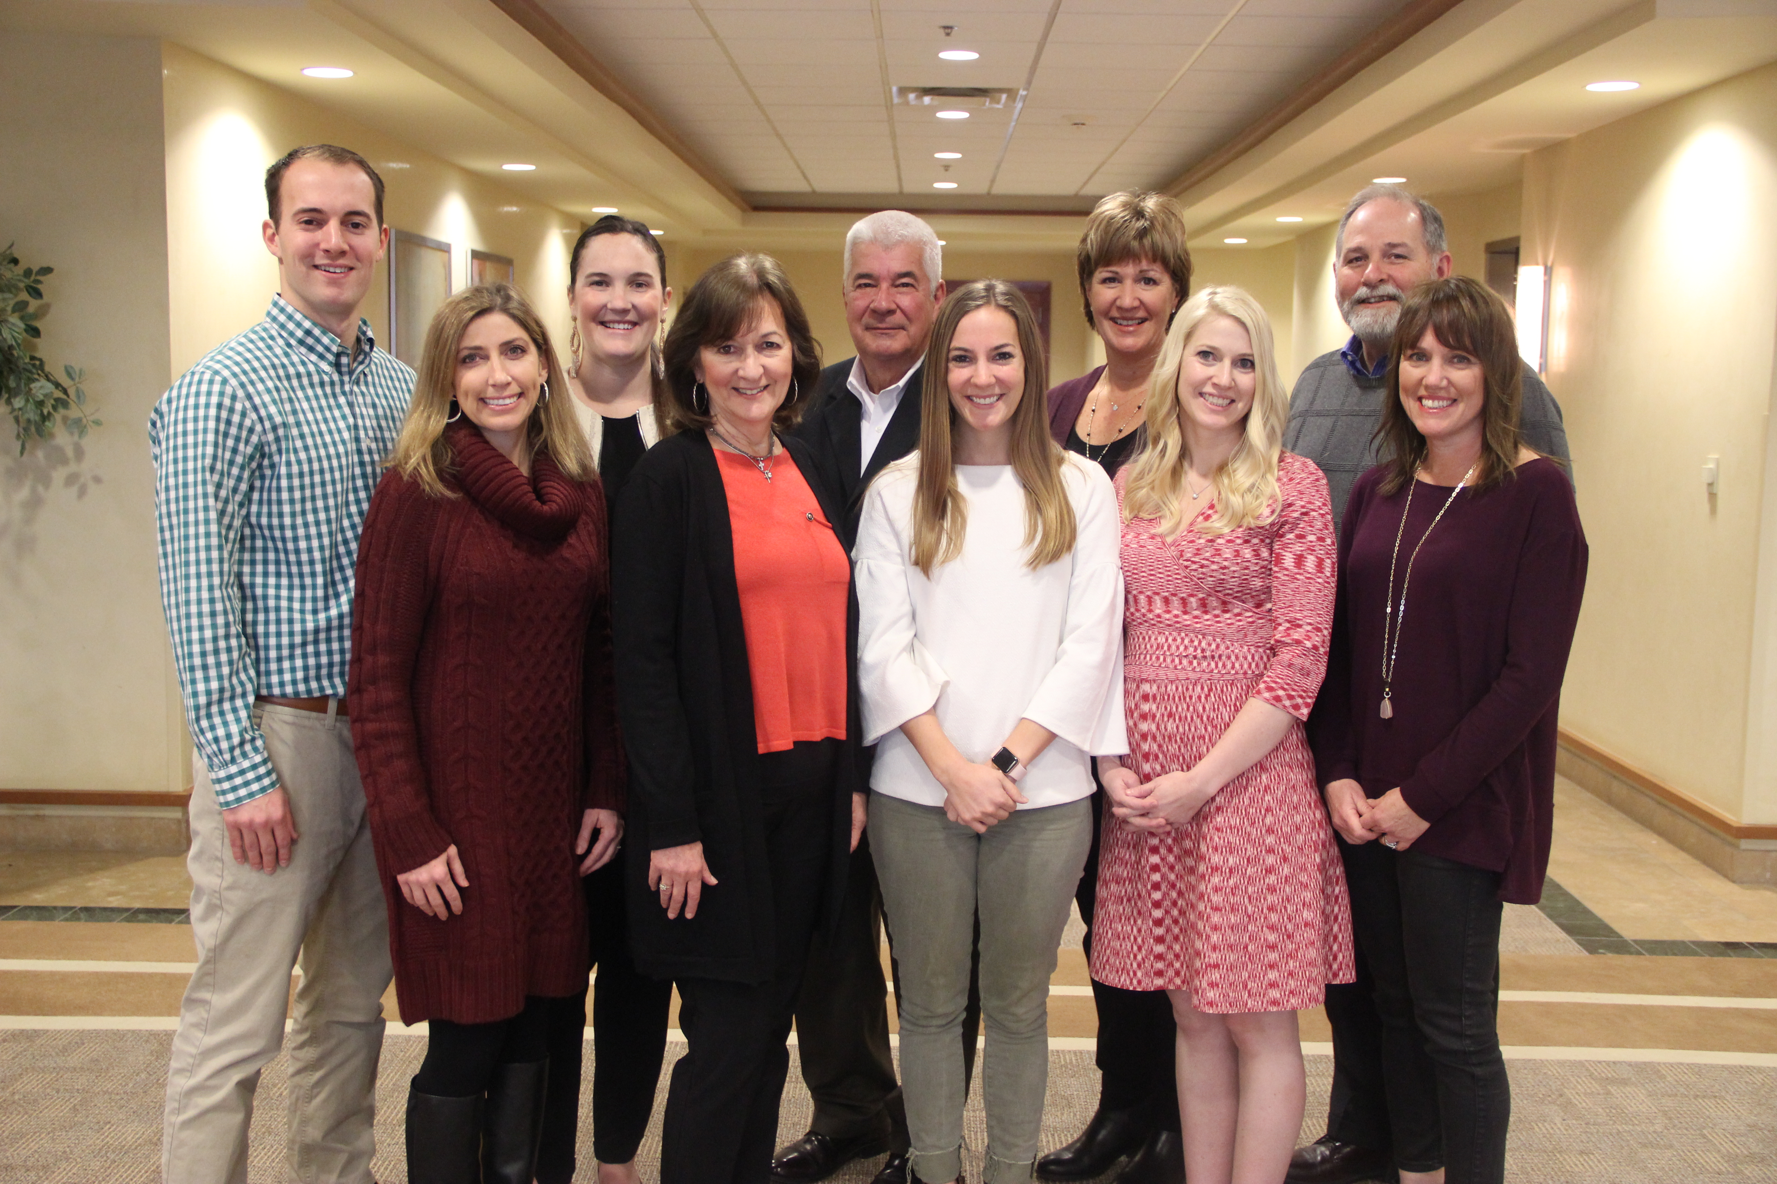
Board and Next Generation Advisory Board (NGAB)
2018 TFF Board – Christine Iovaldi, Brian Buckley, Erin Bird, Jane Schmidt, Jean Buckley, Jill Tracy, John Oliver, Micaela Tracy, Natalie Tracy, & Pat Smith
NGAB
Diana Bittner (Chair)
Kevin Bird (Vice-Chair)
Teresa Sullivan (Secretary)
Nikki Tracy
Ellie Stamerjohn
Jake Schlater
Annie Tracy
Notes:
Presenter: Jean

Slide 6
2018 TFF Committees
COMMITTEE | CHAIR | MEMBERS
Brown County T.E.A.C.H.E.R. Fund | Dan Teefey | Angie, Terry Jenkins, Linda, Jean, Merle
Catholic Schools | Pat Tracy | Susan, Angie, Elizabeth Brown, Brandi Borres, Mark McDowell, Michelle Eversman, Father Tom Meyer, Jean, Dan Teefey
Catholic School Grant Review | Jean Buckley | Susan, Kathi Market, Dan Teefey, Angie
Education | Angie Schlater | Liz , Linda, Terry Jenkins, Erin, Jean, Dan
Investment | Dan Teefey | Lauren, Paul Mugerditchian, Brian Bittner, Alex, Brian Buckley, Mary, & Jean
Leadership | Megan Costigan | Alex, Anne, Fred, John Oliver, John Sullivan, Christine, and Dan Teefey
Youth and Families | Terry Jenkins | Adina, Annie Tracy, Don, Jil, Kelsey, Micaela, Catherine, Megan, Dan Teefey
3G Ozark | Diana Bittner | Annie, Ellie, Jake, Kevin, Nikki, Teresa, Angie, Megan
Long Range 20 Year Planning | Jean Buckley | Pat, John, Linda, Anne, Ben, Liz, Jay Roszhart, Dan Teefey
Notes:
Presenter: Jean

Slide 7
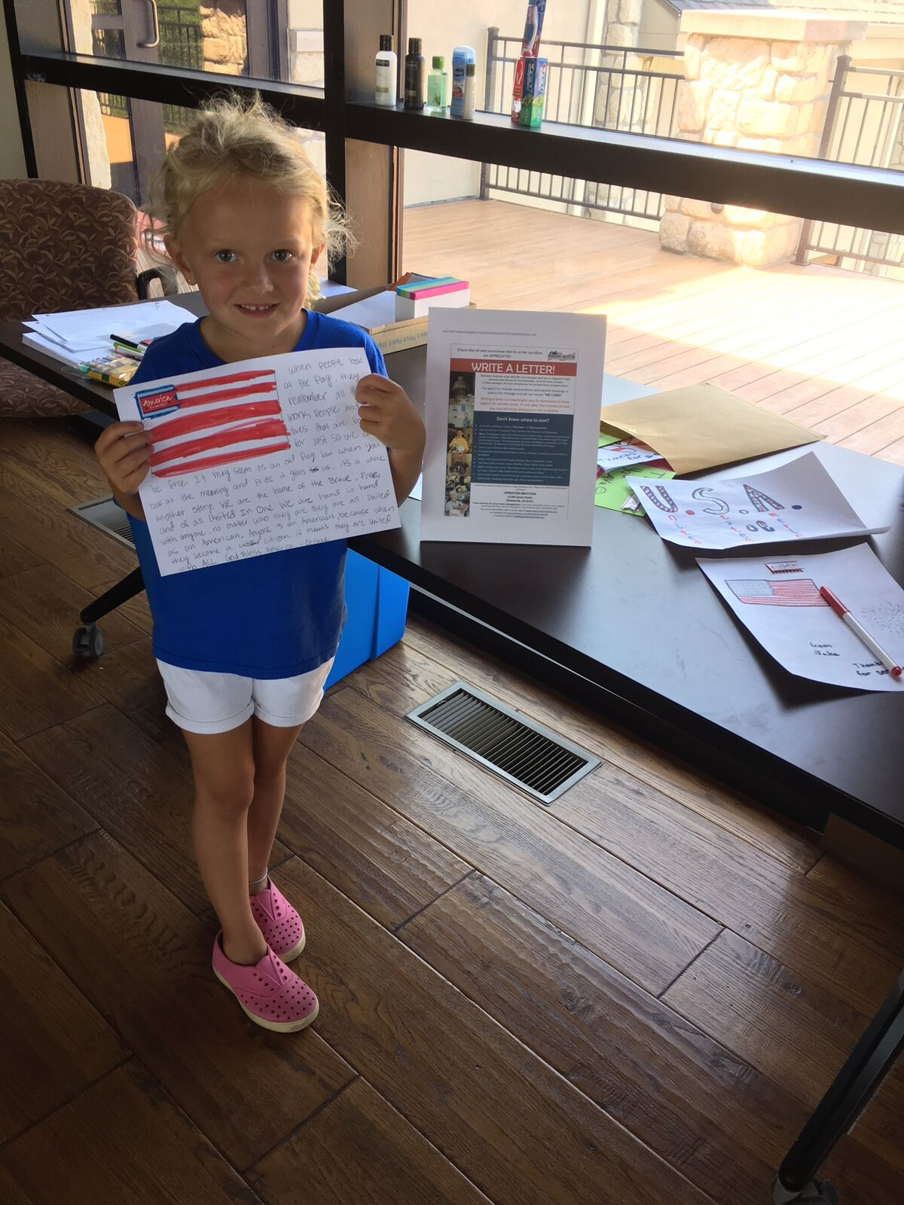
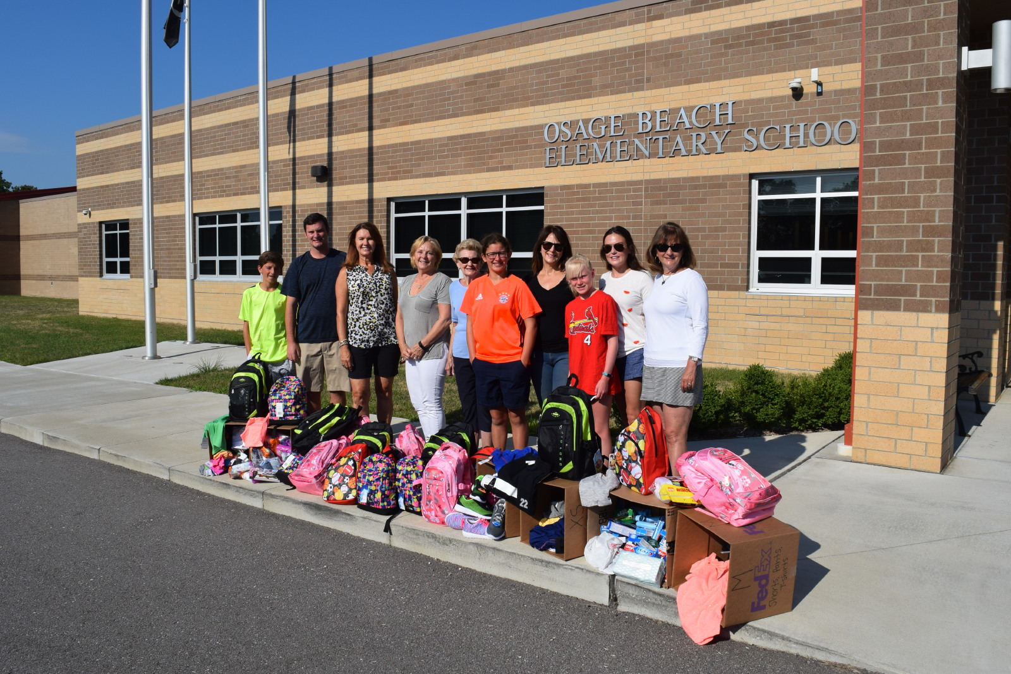
Family Engagement
13
2018
21
2018
55%
2017
86%
2017
100%
2017
100%
2017
# of 2Gs actively engaged in TFF board, committees or staff
# of 3Gs actively engaged in TFF board, NGAB, or committees
Participation by 1Gs and 2Gs in Matching Grant program
Participation by 3Gs in 2017 Matching Grant program
Participation by eligible 3Gs in Next Gen grant program
Participation by eligible 4Gs in Next Gen grant program
Notes:
Presenter: Jean

Slide 8
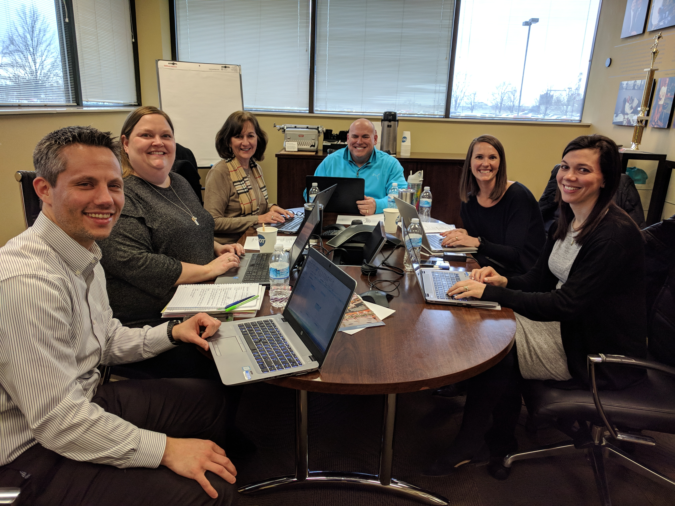
Staff
Jean Buckley, President
Dan Teefey, Executive Director
Kim Bielik, Admin Assistant & Grants Manager
Terry Jenkins, Program Manager
Angie Schlater,
Program Associate
Megan Costigan,
Program Associate
Notes:
Presenter: Jean

Slide 9
Tracy Family Foundation
What are some of the exciting projects that the staff and committees are working on???
20 Year Planning
TFF as the legacy of Grandma & Grandpa Tracy
Increased Family Engagement & Opportunities
BCHS Scholarship Program
Mt. Sterling Uptown Project
BC Early Childcare Center
2018 Brown County Community Survey
School Leadership & Catholic Schools
Improved Communication to Family & Grantees
Strengthening the capacity of nonprofits
Notes:
Presenter: Jean

Slide 10
Questions? Comments?
Notes:
Presenter: Jean

Slide 11
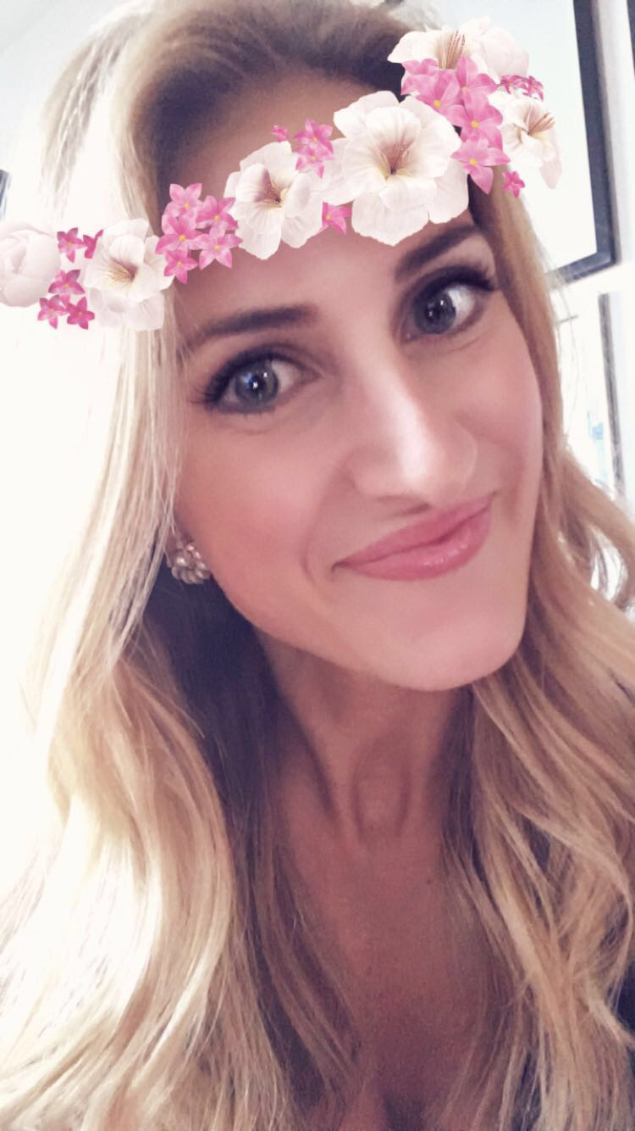
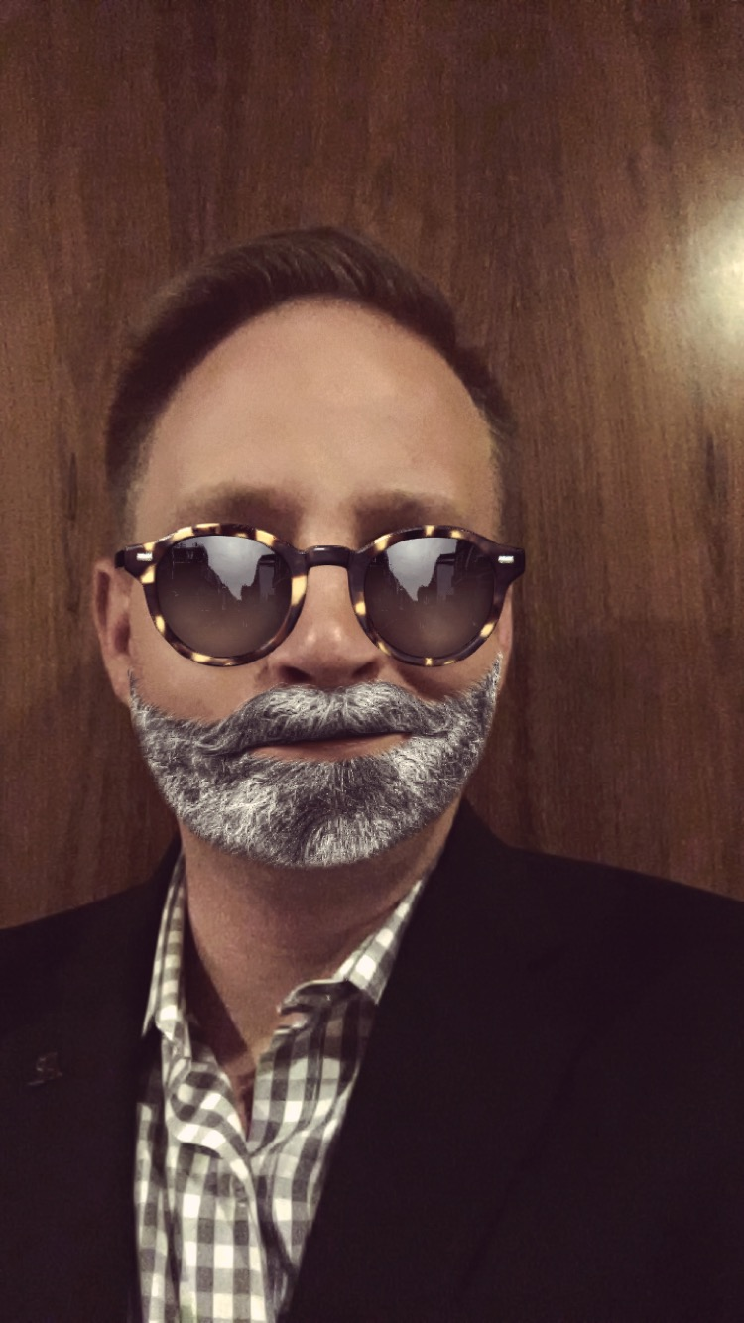
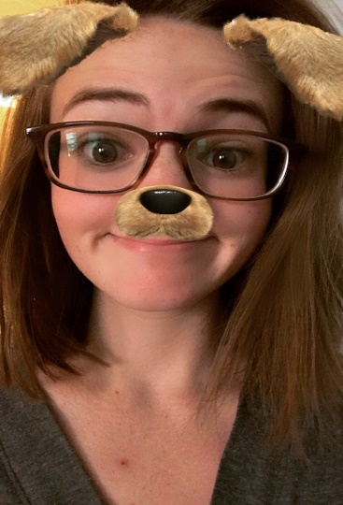
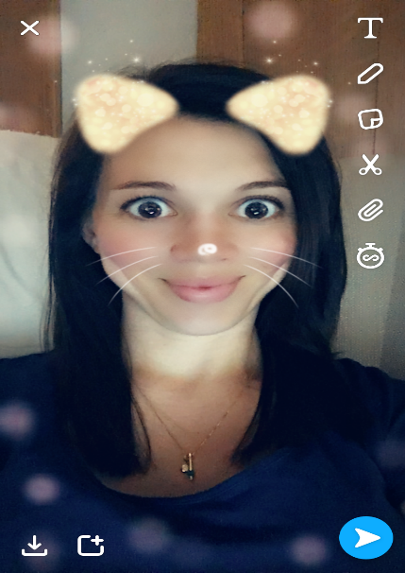
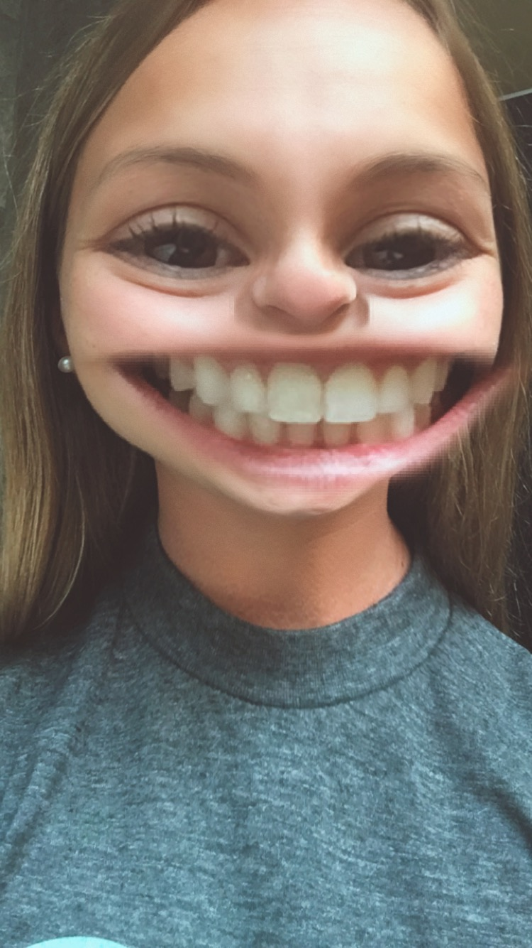
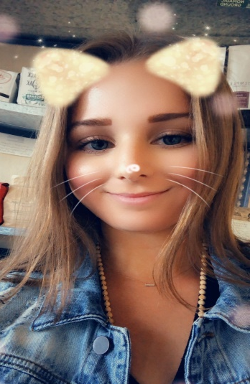
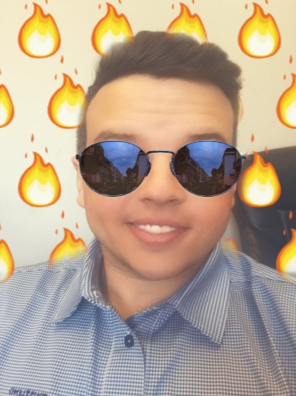
Next Gen Advisory Board 2018
Diana Bittner (Chair), Kevin Bird (Vice Chair), Teresa Sullivan (Secretary),
Annie Tracy, Nikki Tracy, Ellie Stamerjohn and Jake Schlater
TFF Advisor: Megan Costigan
Notes:
Presenter: Nikki

Slide 12
NGAB Update
Mission Statement: The Next Generation Advisory Board exists to cultivate an understanding of philanthropy and build leadership skills in the next generations of the Tracy family. The NGAB will actively listen to all generations offering opportunities, education and support to fulfill the Tracy Family Foundation’s vision for the family.
Special Impact Grant 2017- 2018
Annual Budget: $50,000 (2017) | $100,000 (2018)
2017 SIG Focus Area: Families of Children with Special Needs/Disabilities
Awarded Grantees: The Rise School in Denver, CO | Variety STL in St. Louis, MO|Elizabeth Richardson Center in Fayetteville, AR
2018 SIG Focus Area: Children/Youth affected by Mental Illness
# of 3G Organizations Submitted: 4
Notes:
Presenter: Nikki

Slide 13
Next Gen Grant Program Opportunities
Next Generation Grant Program
3G/4Gs ages 5-30 are eligible
Age 5-17 = $1,000 to give
Age 18-30 = $3,000 to give
Volunteer hours = extra funding
3G Participation in 2017: 86%
4G Participation in 2017: 100%
Matching Grant Program
3G/4Gs age 16 and older are eligible
$50 minimum personal donation; TFF will match at 1:1, 2:1 or 3:1
3G Participation in 2017: 55%
Formal Funding Grant Program
Family Invitation Grant Program
3Gs age 30 and older are eligible
3G Participation in 2017: 11 3Gs
Questions?
2018 Goal
100% participation in each program
All Grant Programs must be in keeping
with the TFF Mission Statement and the
values of Robert & Dorothy Tracy.
Notes:
Presenter: Jake
3G Grant Participation Increases from 2016 to 2017
- Next Gen Grant increased 2% from 2016 to 2017
- Matching Grant increased 24% from 2016 to 2017
- Family Invite Grant increased by 5 people from 2016 to 2017

Slide 14
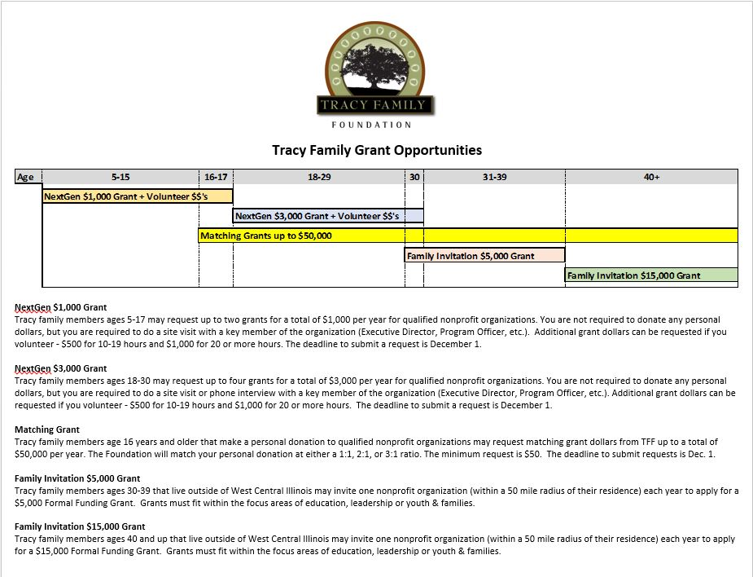
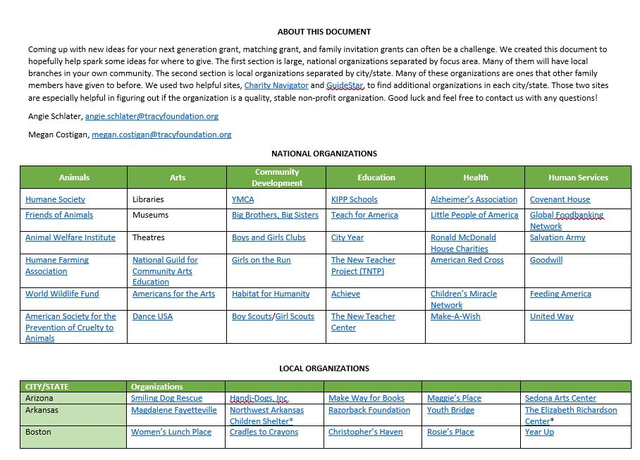
Next Gen Grant Program Opportunities (Cont’d)
Ideas for Giving
Notes:
Presenter: Jake
Note: Angie has copies of the Ideas for Giving document if anyone wants a hard copy. This can also be accessed via the Members Only section of the TFF website.

Slide 15
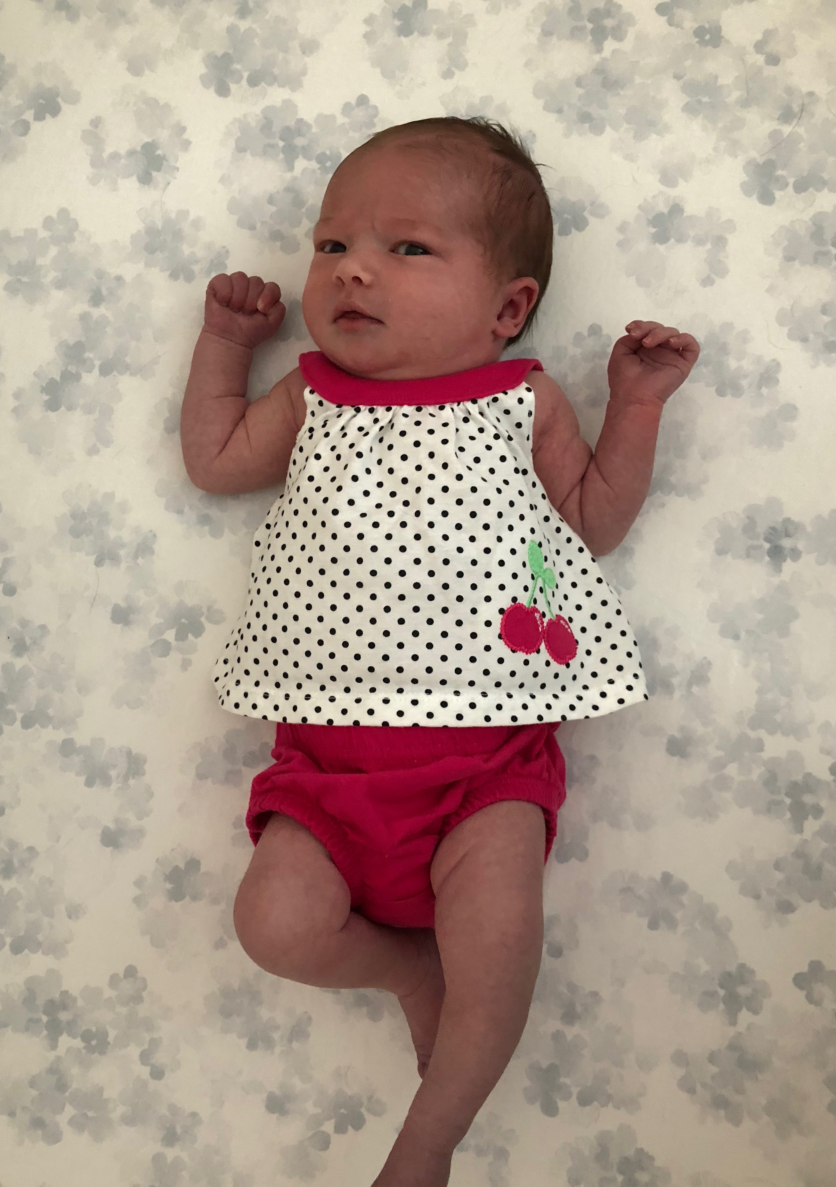
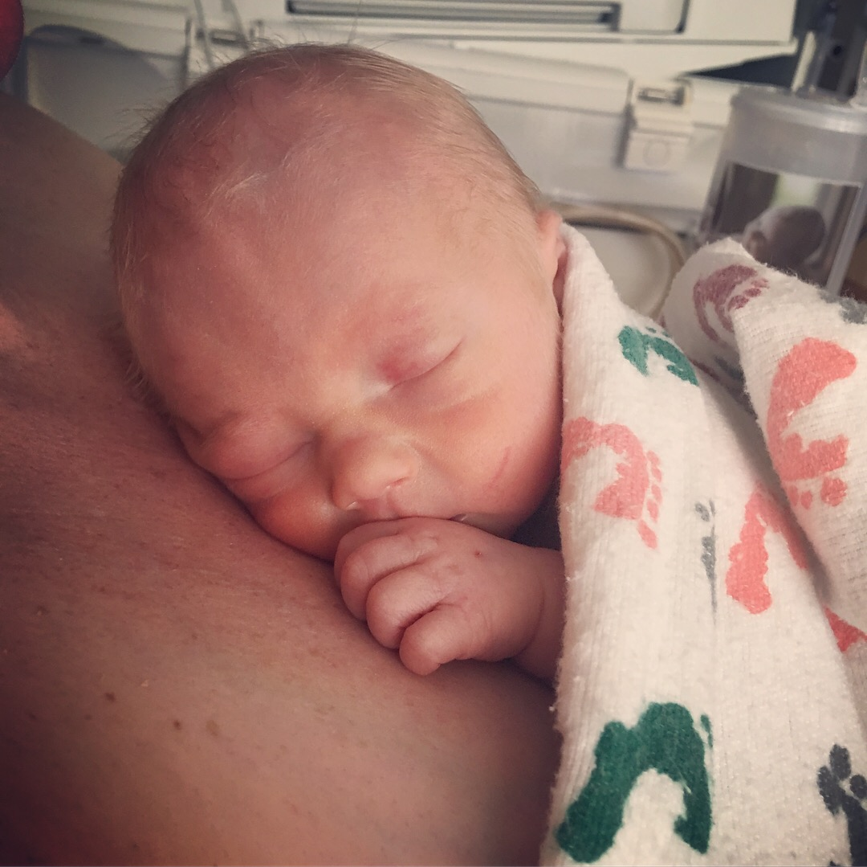
Our Growing Numbers
as of 6/6/18
Our newest 4G additions - Baby Carson and alice! And, 3 more are on the way!
Third Generation | #s
0-4 years old | 0
5-9 years old | 2
10-14 years old | 3
15-19 years old | 6
20-24 years old | 9
25-29 years old | 12
30-39 years old | 30
40+ years old | 0
Total | 62
Fourth Generation | #s
0-4 years old | 19
5-10 years old | 5
Total | 24
Note: 4G numbers include the pregnant moms
Carson
Alice
Notes:
Presenter: Annie

Slide 16
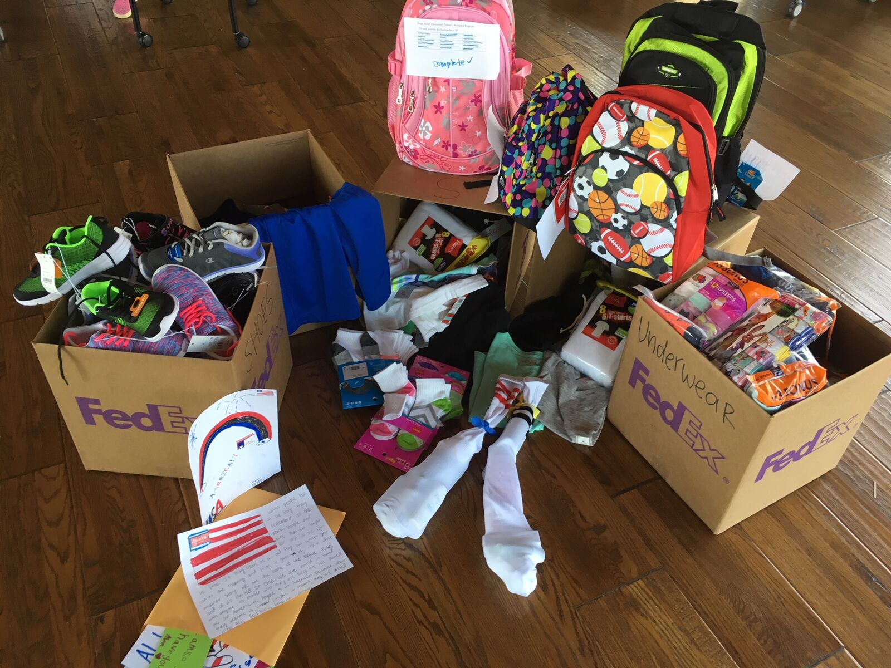
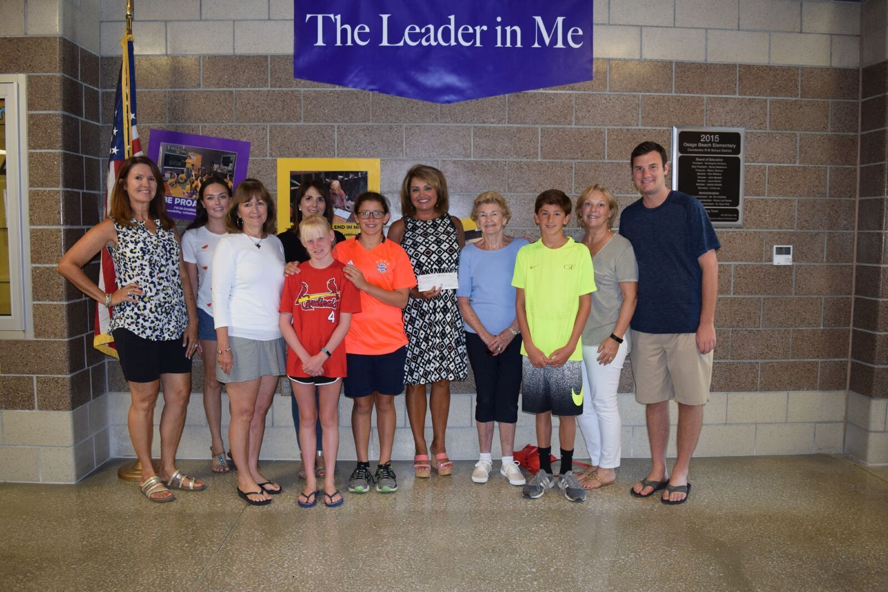
Tracy Family Outreach
2017 Activity: On-site Family Service Activities at RT’s Cove
What: Osage Beach Elementary collections, Socks of Love and Operation Gratitude
2018 Activity
When: June 30 - July 6
Where: Clubhouse
What: Lake Regional Hospital – Cards of Encouragement for Cancer Center Patients and New Mom Baby Packs for the Family Birth Center
Notes:
Presenter: Annie
- Angie will be taking the cards and new mom packs to the hospital Friday morning. Ask for a handful of family to volunteer to go with Angie to help.

Slide 17
Servember The first annual family volunteer month
Purpose: to cultivate a philanthropic spirit in the family. We believe one of the ways to do that is to encourage the family to volunteer and serve others.
What & When: volunteer in your community throughout the month of November
Communication will be sent in August with reminders leading up to Servember
Send pictures/descriptions of your volunteer experience(s) to Megan Costigan
Notes:
Presenter: Angie

Slide 18
Social Media
Purpose
To keep the family engaged and informed on the many projects TFF is working on, on the grant programs available and on the impact that both TFF and the family are having on their communities.
Platform
Instagram
Postings
Each month we will highlight a different topic (i.e. July is TFF History) with weekly postings
TFF Staff will manage
Launch Date – TODAY!
Follow us starting today! @TracyFamilyFoundation
Notes:
Presenter: Angie

Slide 19
How To Videos
We created How To Videos which provide helpful information on how to:
Submit a Next Gen Grant
Submit a Matching Grant
Create a username and password
Edit your settings in Cybergrants
These can be found on the TFF website member’s only section
Notes:
Presenter: Angie

Slide 20
NG and MG Review/Voting
One Minute Introduction of your Nonprofit
Notes:
Presenter: Ellie and Teresa

Slide 21
Introduction
Name of the Organization
What do they do?
Where did your money go?
Notes:
Presenter: Ellie and Teresa

Slide 22
Next Generation Grants
Evo3 Foundation – Alex Tracy
St. Mary School – Ali Tracy
Hardin Middle School – Angie Schlater
Marygrove – Annie Tracy
Quincy YMCA – Ava Terwelp
Chicago HOPES for Kids – Brian Buckley
Our Little Haven – Christine Iovaldi
Big Brothers Big Sisters of Greater Kansas City – Chris Stamerjohn
Advocacy Network for Children – Clare Tracy
Our Little Haven – Dan Iovaldi
Covenant House New York – Diana Bittner
Ducks Unlimited – Drew Stamerjohn
Hoogland Center for the Arts – Liz Tracy
Ashley’s Angels – Ellie Stamerjohn
Stewards Draw– Genavive George
Casa de Salud – Grace Schmidt
Friends of Wings– Hannah Tracy
The Chicago Public Education Fund – Jaclyn Tracy
Endangered Wolf Center– Jake Schmidt
St. Mary School– Jenna Tracy
TacomaPierce County Humane Society– John Sullivan
Paws for Purple Hearts– Julia Capestrain
St. Louis Police Foundation– Katelyn Schmidt
Quincy YMCA– Kate Terwelp
2017 Next Gen Ozark Meeting Winner: Christine Iovaldi
$3,000 for St. Louis Crisis Nursery in St. Louis
Notes:
Presenter: Ellie and Teresa

Slide 23
Next Generation Grants
Purple Asparagus– Kelsey Tracy
St. Mary School– Kristin Tracy
Quincy Park District– Luke Stamerjohn
The Women’s Lunch Place– Maggie Sullivan
Christ in the City– Mark Tracy
Iammore– Matt Tracy
Melrose Family YMCA– Megan Costigan
Kid’s Harbor– Micaela Tracy
Beyond Homeless Inc.– Mike Tracy
Melrose Family YMCA– Michael Costigan
Our Little Haven– Nikki Tracy
St. Mary School– Olivia Tracy
Ursuline Academy– Rachel Hedgecorth
St. Mary School– Sam Tracy
Family to Family – Sam Sullivan
Boston College – Teresa Sullivan
Total Next Gen Grants
2016: $105,500
2017: $105,500
Notes:
Presenter: Ellie and Teresa

Slide 24
3G Matching Grants
Water Legacy– Amelia George
Jacksonville Main Street– Andrew Deuel
Power Inspires Progress– Angie Schlater
Good Shepard Children and Family Services– Annie Tracy
American Red Cross– Ben Tracy
Quincy Notre Dame Foundation, American Red Cross– Brian Buckley
Global Foodbanking Network, Covenant House– Brian Bittner
American Lebanese Syrian Association Char, American Red Cross– Christine Iovaldi
Global Foodbanking Network, Covenant House New York, Beginning with Children, LGBT Youth Out Loud, Little People of America – Diana Bittner
Illinois Bar Foundation – Liz Tracy
Truckers Against Trafficking, St. Louis ARC, Quincy Notre Dame Foundation – Erica Buckley
2017 Next Gen Ozark Meeting Matching Grant Winners:
Erica Buckley and Lauren Clough
$1,500 for Truckers Against Trafficking in Englewood, CO and
$1,500 for Lift for Life Academy in St. Louis
Notes:
Presenter: Ellie and Teresa

Slide 25
3G Matching Grants
Bright by Three, Rocky Mountain Human Services, Project Angel Heart, Global Foodbanking Network, Inner City Health Center, American Red Cross– Erin Bird
The Chicago Public Education Fund– Jaclyn Tracy
United Way– Jay Roszhart
Humane Society of Sedona, Inc– Jenny Capestrain
QND Foundation, The Victim Center, Safe Connections– John Buckley
Memorial Medical Center Foundation, St. Patrick Catholic School, Community Foundation for the Land of Lincoln– Katy Roszhart
Purple Asparagus– Kelsey Tracy
Global Foodbanking Network, Tennyson Center for Children, Firefly Autism, Brent’s Place, No Kid Hungry, Adam’s Camp– Kevin Bird
A Little Help, Project Healing Waters Fly Fishing, The Rise School of Denver, Young Americans Center for Financial Education, Wings of Hope, Global Foodbanking Network, Tennyson Center for Children – Lauren Clough
Total Matching Grants
2016: $32,675
2017: $34,146 (personal $) + $65,292 (TFF $) = $99,438
Notes:
Presenter: Ellie and Teresa

Slide 26
3G Matching Grants
Global Foodbanking Network, Senior’s Resource Center, Warm Hearts Warm Babies, Extended Hands of Hope, Illuminate Colorado– Kenzie Tracy
American Red Cross– Megan Costigan
Hispanic Federation– Micaela Tracy
Christian Brothers College High School– Mike Tracy
Tennyson Center for Children– Natalie Tracy
Project Helping– Rob Tracy
Global Foodbanking Network, Bright by Three, Denver Rescue Mission, The Blue Bench, Arvada Community Food Bank, Tennyson Center for Children– Ryan Tracy
Quincy YMCA– Sara Terwelp
Water Legacy– Steven George
The Women’s Lunch Place- Teresa Sullivan
Notes:
Presenter: Ellie and Teresa

Slide 27
Group Photo
All 3G/4Gs present at the meeting

