Slide 1
Annual 3G Ozark Meeting
August 2015

Slide 2
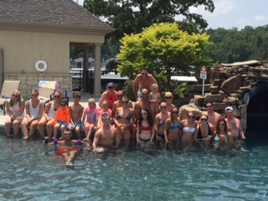
Agenda
TFF Update Aunt Jean
NGAB Update Megan, Kevin
NG and MG Review/Voting Teresa, Mike
2014 YPC Conference Recap Kristin, Jake
Tracy Family Outreach Diana, Christine
Alzheimer’s Initiative Uncle John, Kristin
Group Picture Christine
Notes:
Jean – 5 min
Megan – 10 min
Teresa – 30 min
Ellie/Kristin – 15 min

Slide 3
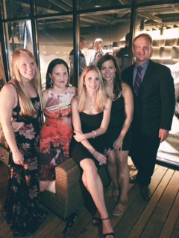
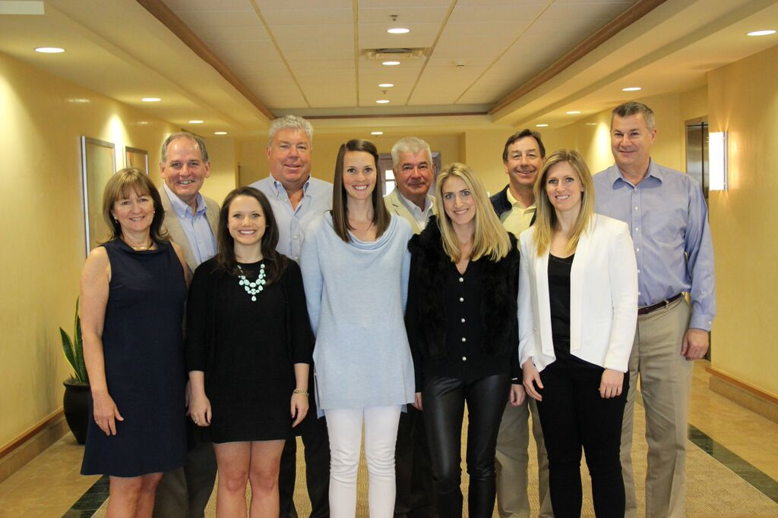
TFF Board & TFF Next Gen Advisory Board
Hmm…4 of 10 are 3Gs…Are they taking over?!!! Last year it was 3 of 10!
We love being on the Next Gen Board!
Our advice to you: Get involved in TFF!

Slide 4
3Gs on Board, NGAB, & Committees
Committee | Members
BC Teacher Fund | Jean (Chair) Jane Tracy, Mary Sullivan, Angie Tracy
Catholic School Education | Pat Tracy (Chair), Jane T, Susan S, Elizabeth Brown, Jean Johnson, Ray Heilmann, Father Tom Meyer, & Jean
Catholic School Grants | Susan S (Chair), Jane Schmidt, Sister Carol Ann, & Jean
Compensation | Smitty (Chair), Mary, & Rob
Education | Jean (Chair), Linda, Angie, Liz, and Terry Jenkins
Investment | Jean (Chair), Rob, Lauren, Brian B, Kristin, Scott, & Mugs Financial Advisor: Mike Ferman – Rubin Brown
Leadership | Jane Tracy (Chair), Mike Tracy, Anne, John O, Wanda, & Erin
Youth & Family | Don Tracy (Chair), Christie Mugerditchian, Erica, Adina, Terry Jenkins & Jean
3G Ozark Meeting | Mike Tracy (Chair), Jake, Kristin, Megan, Christine, Kevin, & Diana
TFF Board | Angie, Diana, Kelsey, Lauren, Smitty, John Oliver, Jim, Fred, Scott, & Jean
Next Gen Advisory Board | Megan (Chair), Christine, Diana, Kevin, & Kristin
Notes:
New Committee: Catholic School Grant Committee

Slide 5
2013-17
Long Range Strategic Plan
Tracy Family Foundation
2013-17 Focus Areas
EDUCATION Brown County and Region
YOUTH AND FAMILIES Brown County and the Region
LEADERSHIP Brown County and the Region
ECONOMIC DEVELOPMENT Brown County Only

Slide 6

Focus Area: EDUCATION
PRO-ACTIVE EFFORTS IN BROWN COUNTY & WEST CENTRAL ILLINOIS
Early Childhood | K-12 | Post-Secondary
Pro-Active Programs | Pro-Active Programs | Pro-Active Programs
 | Brown County Schools | BCHS College Scholarship Program
 | School Leadership Initiative | BCHS/JWCC Dual Credit Scholarship Program
 | Catholic School Initiative

Slide 7

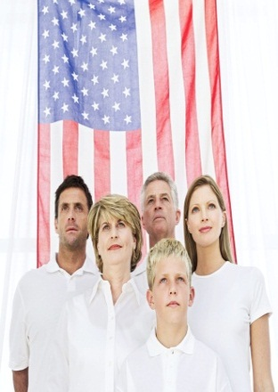
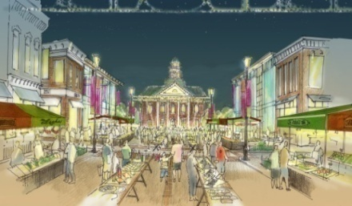
FOCUS AREAS
Leadership Youth & Families
Economic Development in Brown County

Slide 8
3G Grant Program Opportunities
Matching Grant Program
  3Gs age 16 and older are eligible
  TFF will match personal donation at 1:1, 2:1, or 3:1
Next Generation Grant Program
  3Gs ages 5-30 are eligible
  Your volunteer hours = more money for the non-profit!
Formal Funding Grant Program
  Family Invitation Grant Program
  3Gs age 30 and older are eligible

Slide 9
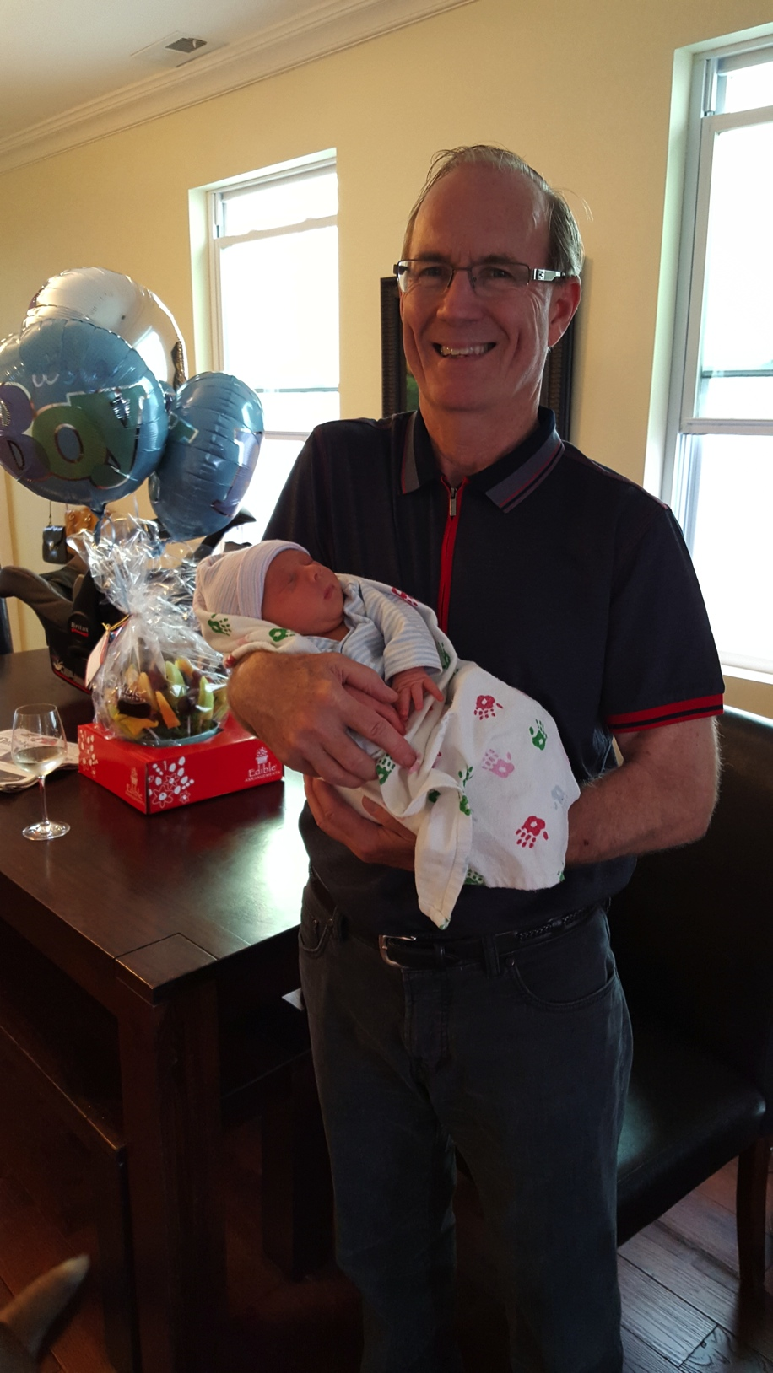
Our Growing Numbers
Third Generation
  55 3Gs (47 3G descendants and 8 3G in-laws)
    30 years of age and older – 16
    Out of College Age – 40
    In College Age – 7
    High School – 3
    Grade School – 5
Fourth Generation
    8 4Gs
      Newborn to 4 years old

Slide 10
NGAB Update
Mission Statement: The Next Generation Advisory Board exists to cultivate an understanding of philanthropy and build leadership skills in the next generations. The board will actively listen to all generations offering opportunities, education and support to fulfill the Tracy Family Foundation’s vision for the family.
2015 Members: Megan (Chair), Christine (Vice Chair), Kristin (Secretary), Kevin and Diana
TFF Grant Cycle, Ozark Meeting
$25,000 Special Impact Grant
  Journey House, Milwaukee, WI
  NW Arkansas Children’s Shelter, Bentonville, AR
  Room at the Inn, St. Louis, MO
  Room to Grow, New York, NY

Slide 11
NG and MG Review/Voting
Thirty Second Introduction of your Nonprofit

Slide 12
2014 Fast Facts
Next Generation Grant:
  Age 5 - 17: $1,000
  Age 18 - 30: $3,000
2014 Total 40 3G Next Gen Grants: $66,500
Matching Grant:
  Age 16 - up : Min. of $50.00 to participate in 1:1, 2:1, 3:1
2014 Total 18 3G Matching Grants: $88,000

Slide 13
Introduction
Name of the Organization
Who they help?
What do they do?
Where does your money go?

Slide 14
3G Next Generation Grants
The Salvation Army Kroc Corps Community Center –Sam, Ali, Liv, and Jenna Tracy
Almost Home Kids – Kelsey Tracy
Big Brothers and Sisters of Greater Kansas City – Chris Stamerjohn
Care Net Pregnancy Services of Quincy | Youth Service Bureau – Mark Tracy
Center of Creative Arts – Hannah Tracy
Children’s Museum Foundation – Jenny Capestrain
Circle of Concern – Jake Schmidt
Circle of Generosity – Diana Tracy
Water Legacy – Steven George
Crystal Bay Township – Amelia George
Elizabeth Ann Seton Program – Jay and Katy Roszhart
Emerge! Center Against Domestic Abuse | Humane Society of Southern Arizona – Julia Capestrain
Family Tree – Erin Bird

Slide 15
3G Next Generation Grants
Gateway 180 – Katelyn Schmidt
Global Foodbanking Network – Alex Tracy
Guiding Eyes for the Blind – Teresa, Maggie, John, and Sam Sullivan
Equip for Equality – Liz Tracy
Harvard School of Excellence | Kissing Well, NFP – Brian Buckley
Redmon and Lee Youth and Adult Community Association – Ellie and Luke Stamerjohn
The Journey House | Stray Rescue – Angie Tracy
Foster & Adoptive Care Coalition – Megan Buckley
Our Little Haven – Nikki and Matt Tracy
Humane Society of Putnam County – Mike Tracy
World Bicycle Relief – Jaclyn Tracy
Quincy Notre Dame – Ben Tracy
Pagnozzi Charities – Drew Stamerjohn
Northwest Arkansas Children’s Shelter, Inc. – Christine Tracy

Slide 16
3G Matching Grants
The Journey House – Angie Tracy
QND Foundation – Chris, Drew, and Luke Stamerjohn
Anchor Center for Blind Children | Firefly Autism | Global Foodbanking Network | Lift for Life Academy | Project Sanctuary – Lauren Tracy
QND Foundation – Megan Buckley
City Meals on Wheels | Commonground | Covenant House NY – Diana Tracy
Quincy YMCA – Eric Terwelp
Muscular Dystrophy Association – Sara Terwelp
Catholic Charities | For the Love of Grace | Metro Care Ring | Tennyson Center for Children – Kevin Bird
Crossroads Safehouse | Global Foodbanking Network | Reading Partners | Sister Carmen Community Center – Erin Bird

Slide 17
3G Matching Grants
Community Foundation for the Land of Lincoln – Jaclyn Tracy
Operation Food Search – John Buckley
Wyman Center – Erica Tracy
Youth Service Bureau – Mark Tracy
The Humane Society of Putnam County – Mike Tracy
ACE Scholarships | BBBS of Colorado | Florence Crittenton Services of Colorado | Food Bank of the Rockies | Tennyson Center for Children | Global Foodbanking Network | Women’s Bean Project – Ryan Tracy
Fellowship for International Community | Water Legacy –
Steven George

Slide 18
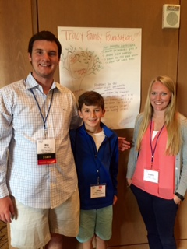
2015 YPC Recap
Midwest Regional Gathering in Indianapolis
Attendees: Linda, Kristin, Jake & Mike
Mike served as a Program Fellow for YPC

Slide 19

Tracy Family Outreach
First family activity - August 2014 at Share the Harvest Food Pantry.
  25 + 2G, 3G, and 4G family volunteers
Wonderland Camp
To provide a fun, educational camp experience for children, teenagers and adults who have disabilities; to offer a respite from daily care giving for their family members and healthcare workers; and to provide and nurture a personal development experience for volunteers and staff.
Tuesday , August 4th from 6:00 pm – 8:30 pm
  Help setup a carnival for the campers and other projects

Slide 21


WALK TO END ALZHEIMER’S
Fall 2015 Dates & Locations
Quincy, IL: Thurs. 9/3
St. Louis, MO: Sat. 9/12
Springfield, IL: Sat. 9/19
Chicago, IL: Sun. 9/27
Denver, CO: Sat. 9/19
Milwaukee, WI: Sun. 9/20
Bentonville, AR: Sat. 9/12
Newport, RI: Sun. 9/27
Camdenton, MO: Sat. 9/26
Tacoma, WA: Sun. 9/13
Boston, MA: Sun. 9/27
Duluth, MN: Sat. 9/12
Indianapolis, IN: Sat. 10/10
New York, NY: Sun. 10/18
Brooklyn, NY: Sun. 10/4
Tucson, AZ: Sat. 11/7
Naples, FL: Sat. 11/7
Notes:
Source: http://act.alz.org/site/PageServer?pagename=walk_homepage

