Slide 1

Annual Next Gen Ozark Meeting
July 2016

Slide 2
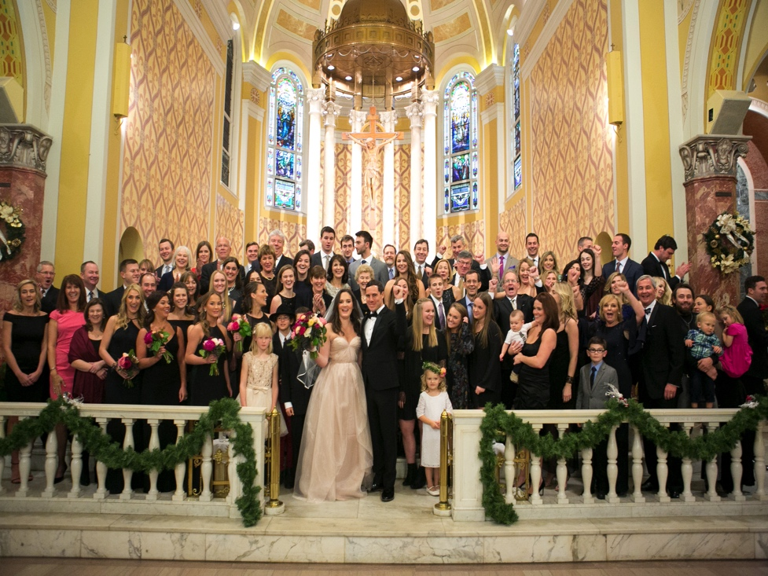
Agenda
TFF Update Aunt Jean
NGAB Update Christine
New Resources Kenzie
Tracy Family Outreach Diana
NG and MG Review/Voting Nikki, Kristin
Group Picture 3G’s and 4G’s

Slide 3
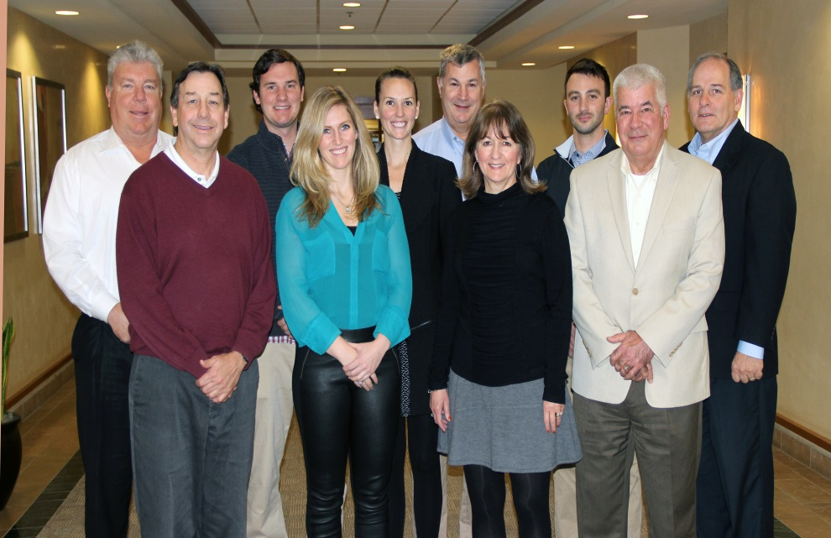
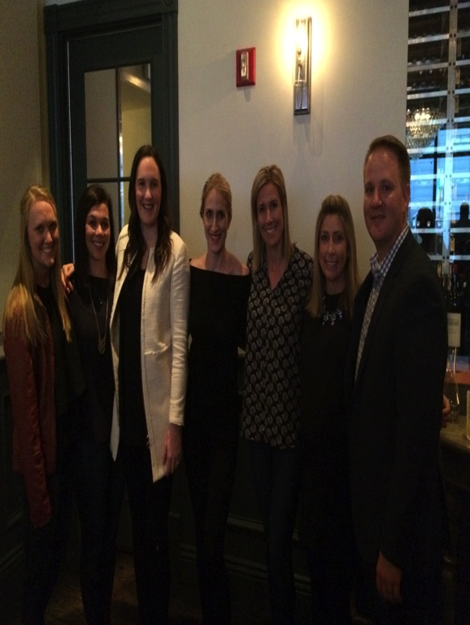
TFF Board & TFF Next Gen Advisory Board
Hmm…Two years in a row….4 of 10 are 3Gs…Are they taking over?!!!
We love being on the Next Gen Board!
Our advice to you: Get involved in TFF!
Notes:
Mike will insert a new picture taken in Denver.
Jean insert a new board picture.

Slide 4
3Gs on Board, NGAB, & Committees
Committee | Members
BC Teacher Fund | Jean (Chair), Terry Jenkins, Angie, & Linda T
Catholic School Education | Pat Tracy (Chair), Jane T, Susan S, Elizabeth Brown, Brandi Borries, Michelle Eversman, Ray Heilmann, Father Tom Meyer, & Jean
Catholic School Grants | Jean (Chair), Jane S, Sister Carol Ann, & Susan S
Compensation | Smitty (Chair), Mary, & Rob
Education | Jean (Chair), Linda, Angie, Liz, Mary, & Terry Jenkins
Investment | Brian B (Chair), Lauren, Drew, Scott, & Mugs Financial Advisor: Mike Ferman – Rubin Brown
Leadership | Jane Tracy (Chair), Mike T, Anne, John O, Fred, & Erin
Youth & Family | Terry Jenkins (Chair), Christie Mugerditchian, Annie T, Adina, Jil T, Lauren, & Jean
3G Ozark Meeting | NGAB (Chair), Linda Tracy, Mike Tracy
TFF Board | Angie, Drew, Mike T, Lauren, Smitty, John Oliver, Jim, Fred, Scott, & Jean
Next Gen Advisory Board | Megan (Chair), Christine, Diana, Kevin, Kristin, Kenzi, Natalie, & Nikki
Notes:
Jean: Update

Slide 5
TFF GRANT PROGRAMS
Grant Programs
Matching
Next Generation
Capacity Building
Catholic Schools
Brown County Teacher Fund
Formal Funding

Slide 6
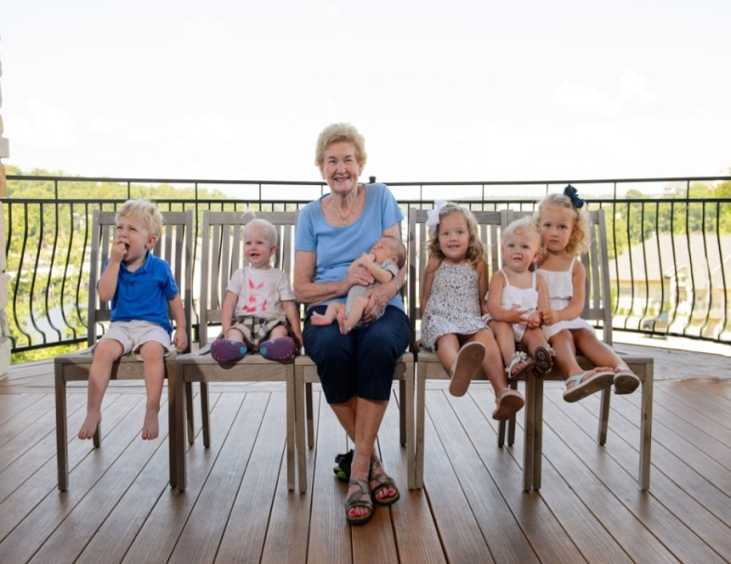
Next Gen Grant Program Opportunities
Matching Grant Program
  3G/4Gs age 16 and older are eligible
  TFF will match personal donation at 1:1, 2:1, or 3:1
Next Generation Grant Program
  3G/4Gs ages 5-30 are eligible
  Your volunteer hours = more money for the non-profit!
Formal Funding Grant Program
  Family Invitation Grant Program
  3Gs age 30 and older are eligible
  All Grants for All Grant Programs must be in keeping with the TFF Mission Statement and the values of Robert & Dorothy Tracy.
Notes:
Next Gen Grant
Linda will update.
This will be Jean’s slides. ……
MG: Talk about MG and Final Report. Talk about in keeping with Mission and Values of Robert & Dorothy Tracy
Next Gen: 4Gs now eligible. In the year they turn 5, they can do a Next Gen grant. Will give them a year of giving to volunteer.
Formal Funding Grant: In their 30th year, note individually, not a couple.

Slide 7
2013-17
Long Range Strategic Plan
Tracy Family Foundation
2013-17 Focus Areas
EDUCATION Brown County and Region
YOUTH AND FAMILIES Brown County and the Region
LEADERSHIP Brown County and the Region
ECONOMIC DEVELOPMENT Brown County Only
Notes:
Ok

Slide 8
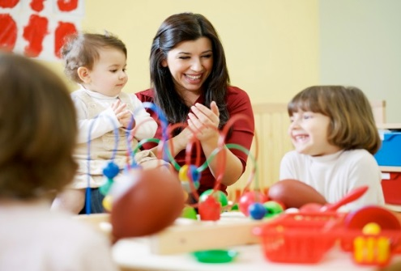


FOCUS AREA: EDUCATION
Early Childhood
K-12
Post-Secondary

Slide 9

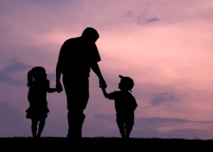
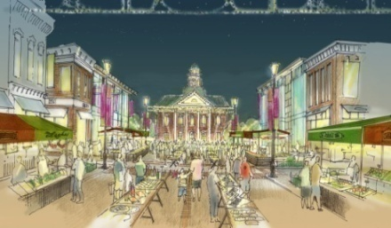
FOCUS AREAS
Leadership Youth & Families
Economic Development in Brown County
Notes:
Ok…Change as needed

Slide 10

TFF RETREAT
Kick-Off Dinner Date: Friday, November 11, 2016
Retreat Date: Saturday, November 12, 2016
Location: Hagel 1891 – Mt. Sterling
Time: 9:00 am – 4:00 pm
Purpose: To Plan for the Future!
Who is Invited? All Tracy family members high school age and older, TFF trustees, & TFF staff
Who will have Fun? EVERYONE!!!
Want to help plan the Retreat? See Aunt Jean after the meeting.

Slide 11
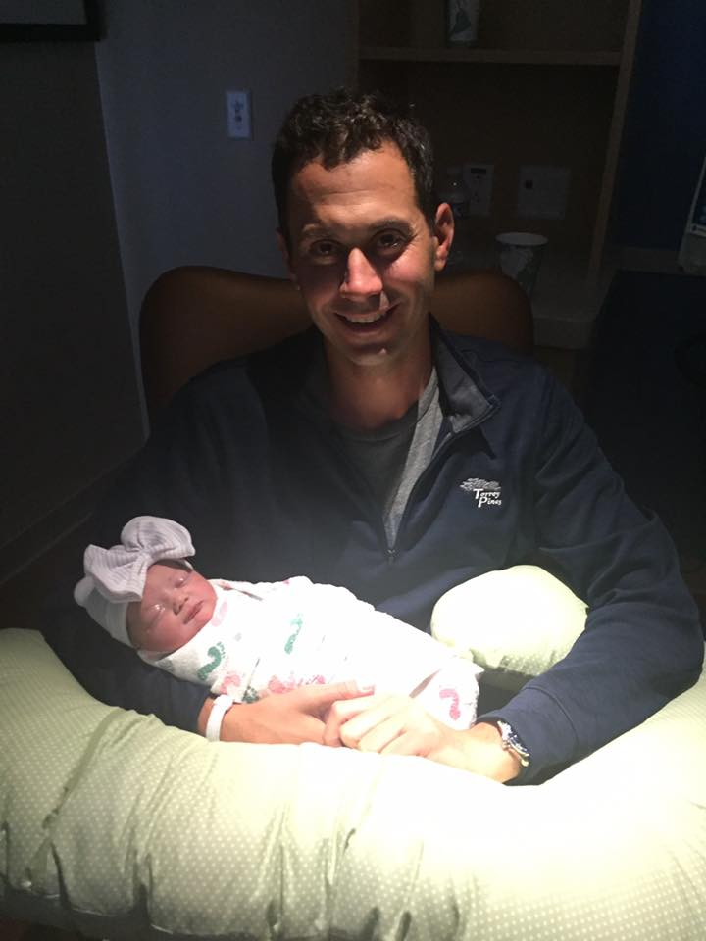
Our Growing Numbers
Third Generation
  60 3Gs (47 3G descendants and 13 3G in-laws)
    30 years of age and older – 17
    Out of College Age – 28
    In College Age – 7
    High School – 3
    Grade School – 5
Fourth Generation
    13 4Gs (including the pregnant moms)
      Newborn to 5 years old

Slide 12
NGAB Update
Mission Statement: The Next Generation Advisory Board exists to cultivate an understanding of philanthropy and build leadership skills in the next generations. The board will actively listen to all generations offering opportunities, education and support to fulfill the Tracy Family Foundation’s vision for the family.
2016 Members: Megan (Chair), Christine (Vice Chair), Diana (Secretary), Kenzie, Kristin, Kevin, Natalie and Nikki
13 3Gs have participated on NGAB
43 Formal Funding grants reviewed and $188,604 recommended to TFF
  2015 SIG: Room to Grow, New York, NY and NW Arkansas Children’s Shelter, Bentonville, AR
  2016: $50,000 Special Impact Grant

Slide 13

Next Gen Resources
Next Gen Book
Site Visit Worksheet

Slide 14

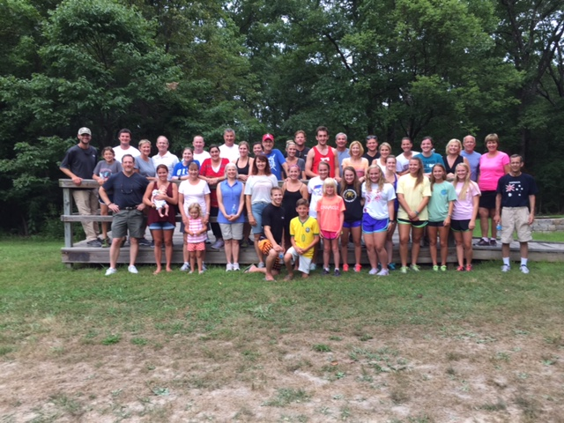
Tracy Family Outreach
2nd annual family activity at Wonderland Camp - August 2015
  40+ 2G, 3G, and 4G family volunteers
Tuesday, July 5th from 9am – 11am
Wonderland Camp
  Camp Improvement Day

Slide 16
NG and MG Review/Voting
One Minute Introduction of your Nonprofit

Slide 17
Introduction
Name of the Organization
What do they do?
Where did your money go?

Slide 18
3G Next Generation Grants
African Lion and Environment Research Trust – Julia Capestrain
Almost Home Kids – Kelsey Tracy
Amigos for Christ – Ben Tracy
Amos House – Sam Sullivan
Big Brothers, Big Sisters of Greater Kansas City – Chris Stamerjohn
Boston College Campus School – Teresa Sullivan
Burns Recovered Support Group – Hannah Tracy
Christian Brothers College High School – Mike Tracy
Community Activism Law Alliance – Liz Tracy
Edible Schoolyard – Diana Tracy
Embarc – Jaclyn Tracy
Foster & Adoptive Care Coalition – Megan Costigan
Age 5 - 17: $1,000 Age 18 - 30: $3,000

Slide 19
3G Next Generation Grants
Gateway 180 – Jake, Gracie, and Katelyn Schmidt
Global Food Banking Network – Brian Buckley
IamMORE Foundation – Matt Tracy
Illinois Reading Council – Alex Tracy
Le Bonheur Children’s Hospital – Ellie Stamerjohn
Operation Food Search – John Buckley
QUANDA – Jenna, Olivia, Samantha, Ali, and Kristin Tracy
St. Vincent de Paul – St. Elizabeth – Zach Tracy
Teaching Drum Outdoor School – Amelia George
The Women’s Lunch Place – Maggie Sullivan
Wonderland Camp – Angie Tracy
Friends of Kids with Cancer – Nikki Tracy
2014 : $66,500
2015 Total Next Gen Grants : $79,500

Slide 20
3G Matching Grants
Almost Home Kids – Kelsey Tracy
Autism Society of Southeastern Wisconsin – Angie Tracy
Big Brothers, Big Sisters of Colorado – Kevin Bird
Room to Grow – Diana Tracy
Heart & Hand Center – Erin Bird
Hands up for the Children – Kenzie Tracy
Equip for Equality – Liz Tracy
Age 16 - up : Min. of $50.00 to participate in 1:1, 2:1, 3:1

Slide 21
3G Matching Grants
Food Bank of the Rockies – Ryan Tracy
Mount St. Vincent Home – Lauren Tracy
Muscular Dystrophy Association – Sara Terwelp
Pleasantville Fund for Learning – Maggie Sullivan
St. Mary School – Ben Tracy
Youth In Need – Erica Buckley
The Global Foodbanking Network – Rachel Hedgecorth
2014: $88,000
2015 Total 3G Matching Grants: $21,580

