Slide 1

Annual Next Gen Ozark Meeting
July 2017

Slide 2
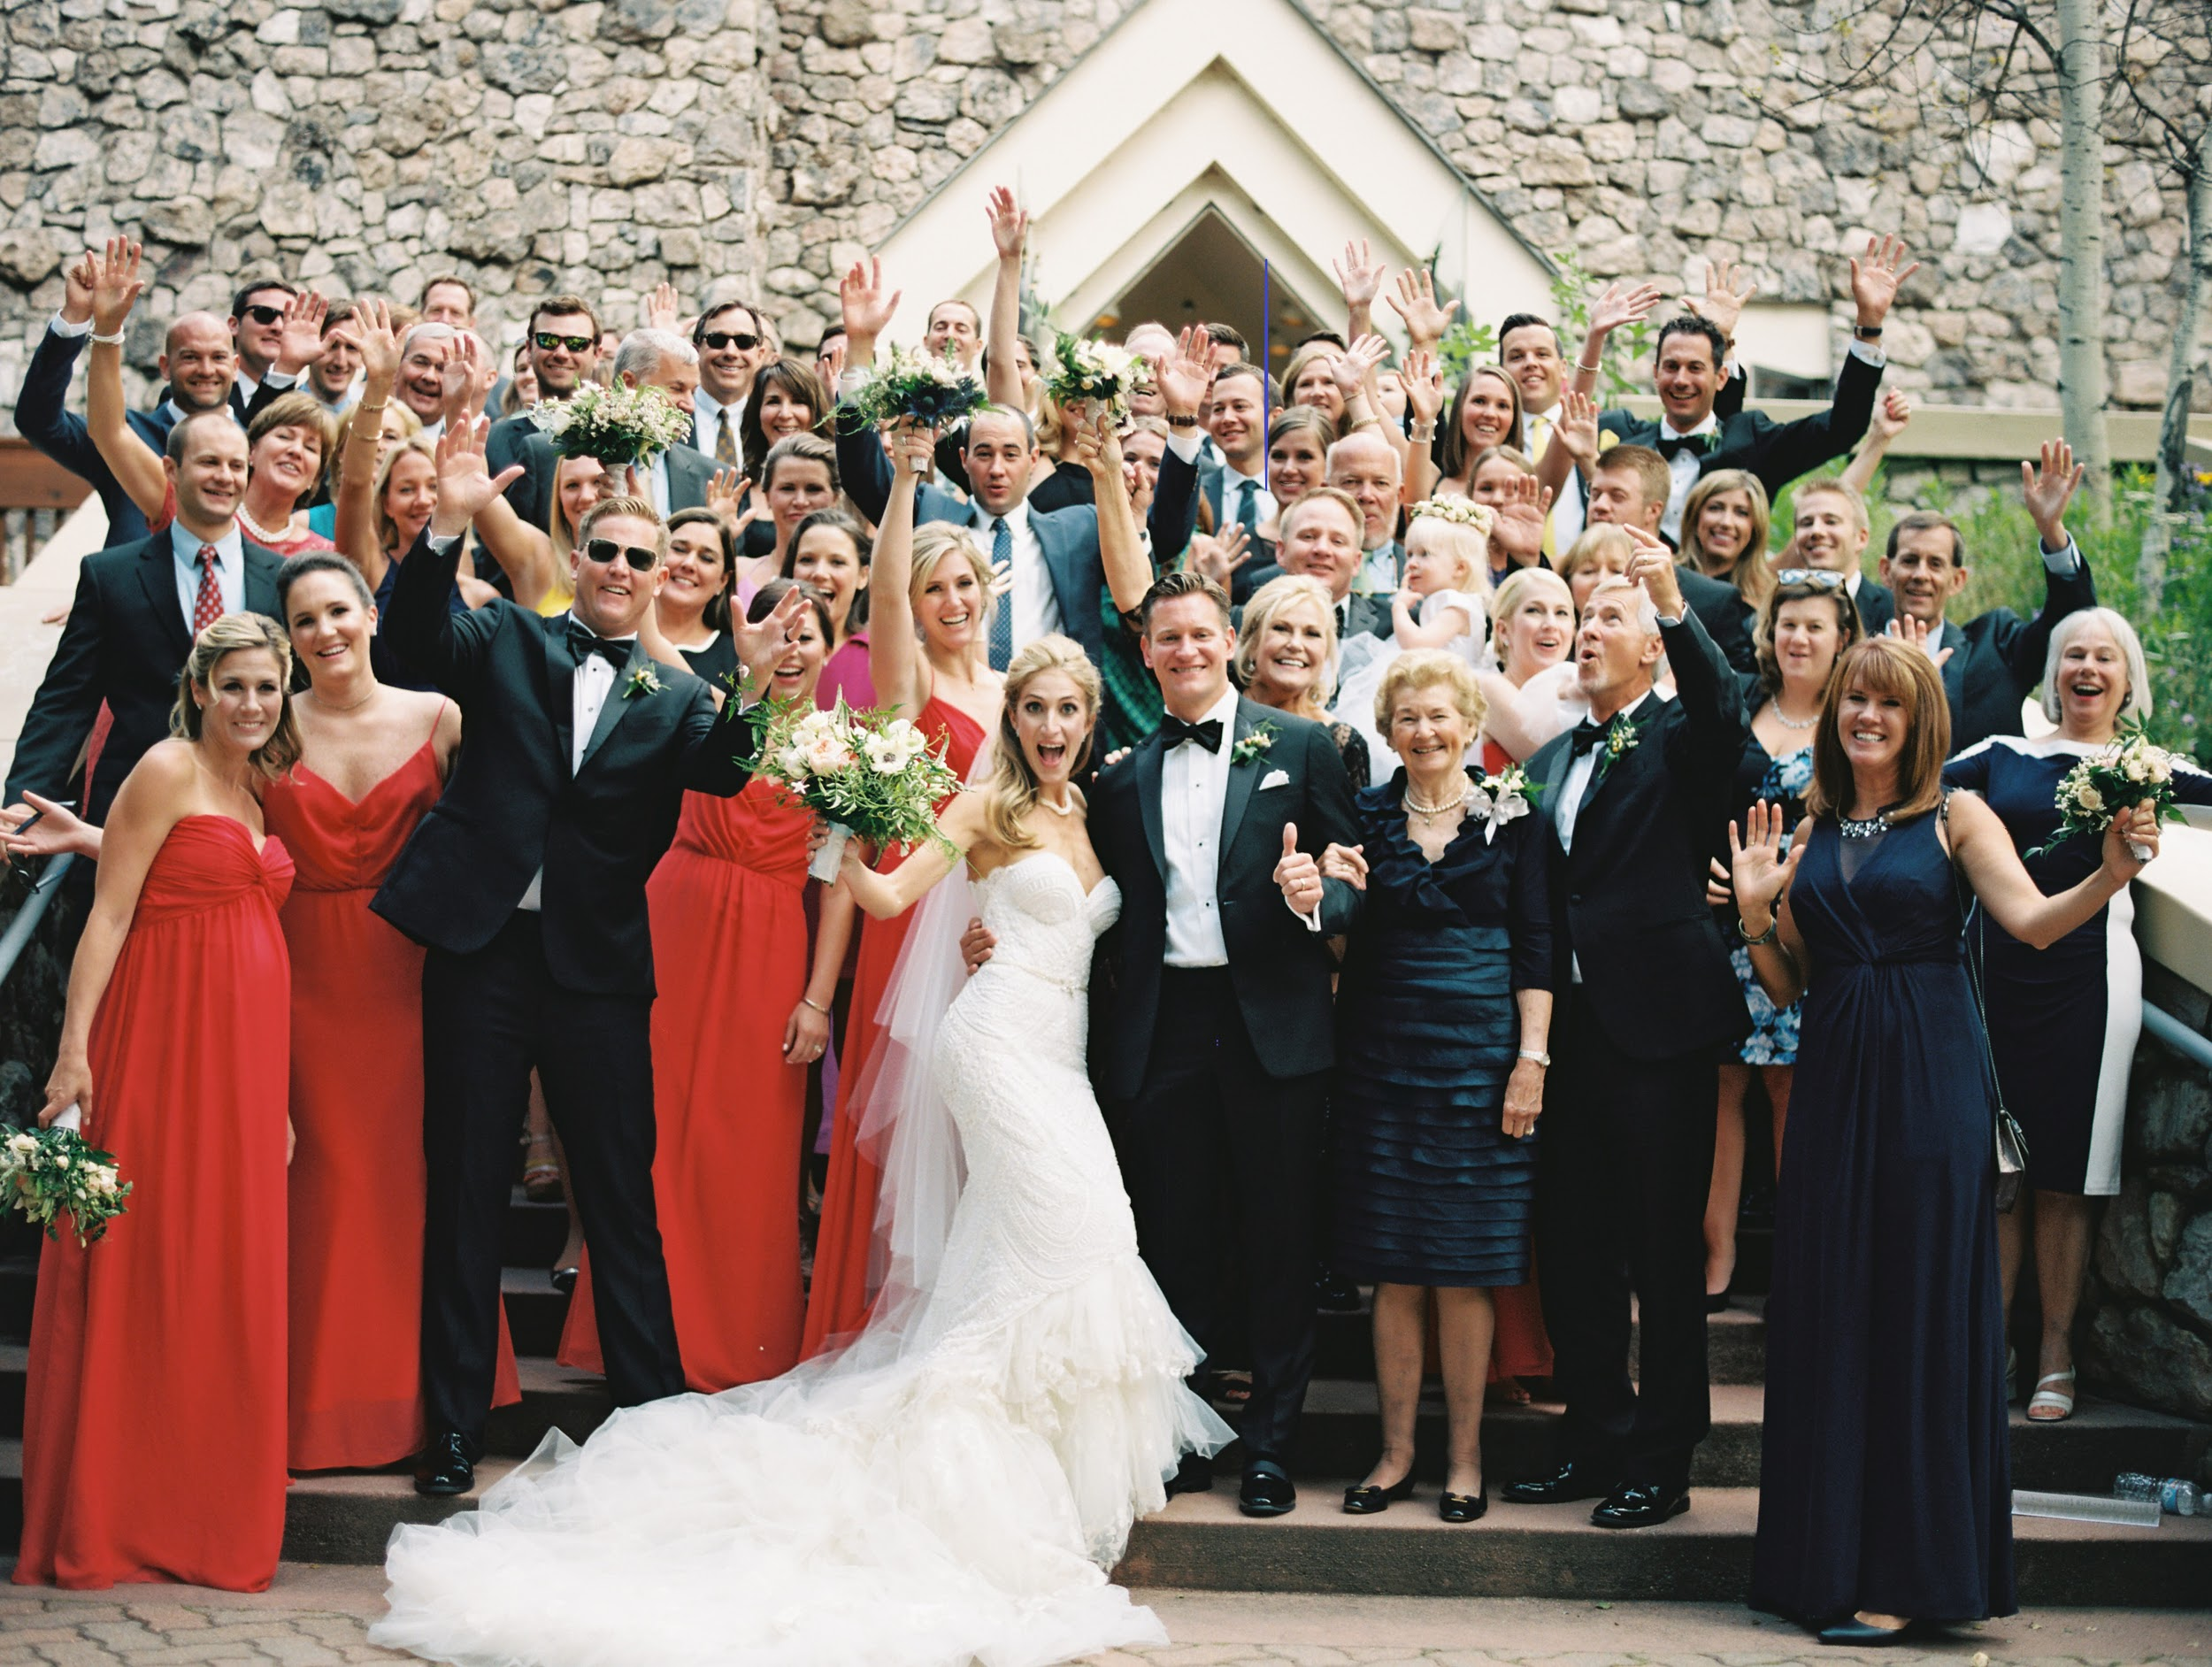
Agenda
TFF Update
NGAB Update
3G Grant Opportunities / Teachable Moments
Growing Numbers / Tracy Family Outreach
NG and MG Review/Voting
Group Picture

Slide 3


Tracy Family Foundation
Once again, I cannot wait to hear Aunt Jean’s presentation!
3G ANNUAL
MEETING
July 2017

Slide 4
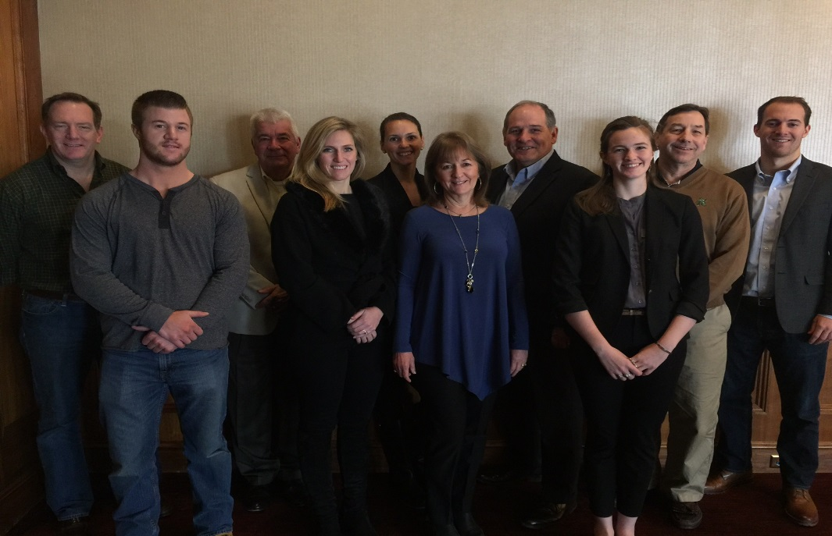
Board and Next Generation Advisory Board (NGAB)
2017 TFF Board – Angie Tracy, Brian Buckley, Jay Sullivan, Jean Buckley, John Oliver, Lauren Tracy, Teresa Sullivan, Pat Smith, Scott Stamerjohn, & Tim Capestrain
NGAB
Diana Bittner (Chair)
Christine Iovaldi (Vice-Chair)
Kenzie Tracy (Secretary)
Kevin Bird
Natalie Tracy
Nikki Tracy
Ellie Stamerjohn
Jenny Capestrain

Slide 5
2017 TFF Committees
COMMITTEE | CHAIR | MEMBERS
Brown County T.E.A.C.H.E.R. Fund | Jean | Angie, Terry Jenkins, Linda
Catholic Schools | Pat Tracy | Susan, Jane Tracy, Angie, Elizabeth Brown, Brandi Borres, Ray Heilmann, Michelle Eversman, Father Tom Meyer, Jean
Catholic School Grant Review | Jean | Susan, Sister Carol Ann Smith, Kathi Market
Education | Jean | Liz , Angie, Linda, Terry Jenkins, Erin
Investment | Brian Buckley | Lauren, Scott, Paul Mugerditchian, Brian Bittner, Alex, Mike Tracy, Mary, Jean
Leadership | Megan Costigan | Mike Tracy, Alex, Anne, Fred, John Oliver
Youth and Families | Terry Jenkins | Christie Mugerditchian, Adina, Annie Tracy, Don, Jil, Kelsey, Micaela, Jean
3G Ozark | Linda | Diana, Christine, Ellie, Jenny, Kenzie, Kevin, Natalie, Nikki, Mike Tracy, Gracie, & Katelyn
2018-2022 Long Range Planning | Jean | President, Executive Director, Program Manager, NGAB member, 1 -2 Board members, 2 – 4 family members not on TFF board (2Gs and 3Gs)

Slide 6
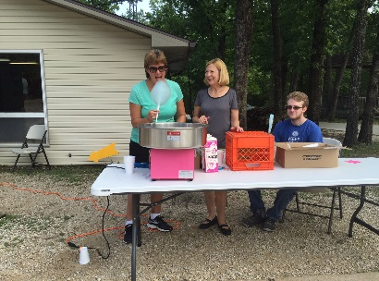
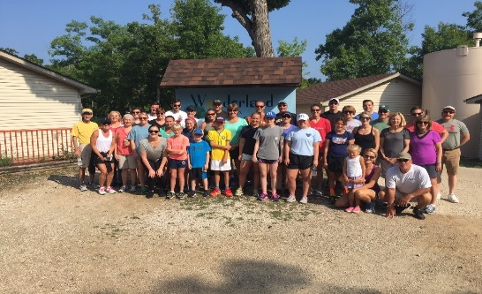
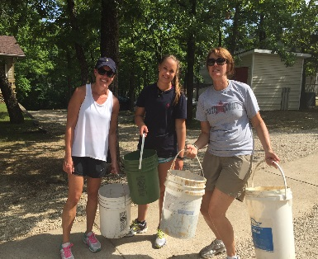
Family Engagement
16
2017
21
2017
44
2016
100%
2016
31%
2016
84%
2016
# of 2Gs actively engaged in TFF board, committees, staff, or Dot family directors
# of 3Gs actively engaged in TFF board, NGAB, or committees
# of 2Gs, 3Gs, and 4Gs who participated in the family volunteer project at Camp Wonderland
Participation by 1Gs and 2Gs in Matching Grant program
Participation by 3Gs in 2016 Matching Grant program
Participation by eligible 3Gs in Next Gen grant program

Slide 7
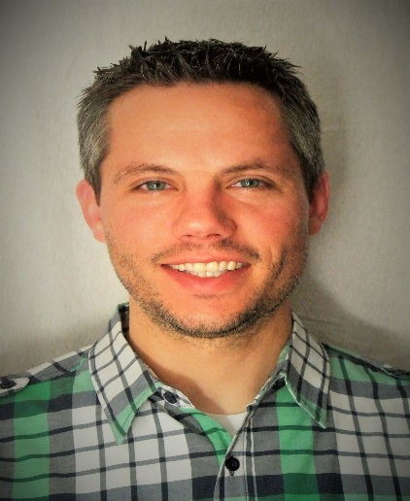
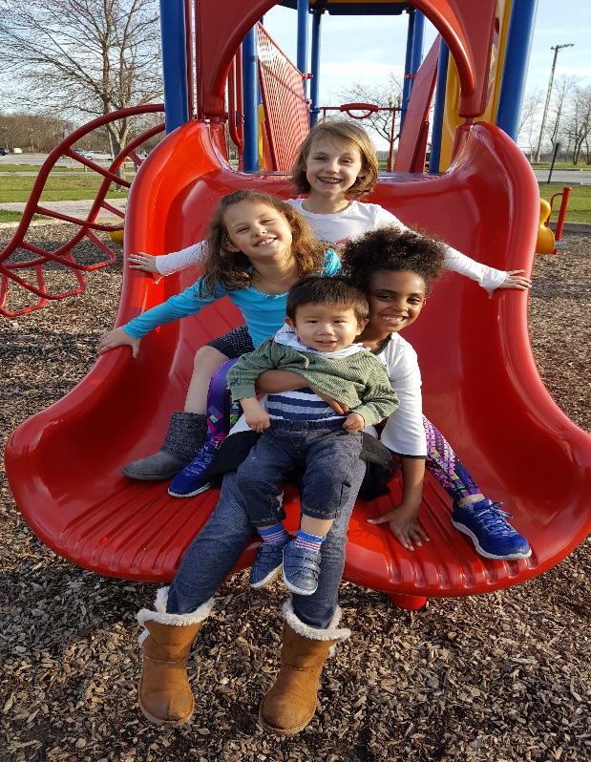
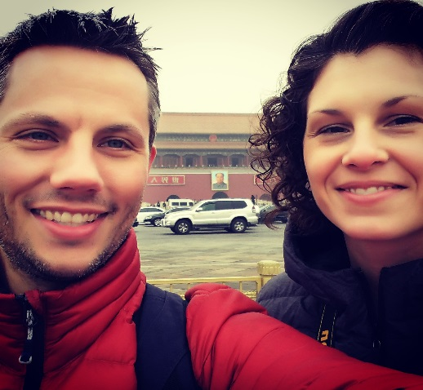
Staff
Introducing the new TFF Executive Director….Dan Teefey!
Jean, President
Soon! Dan Teefey, Executive Director
Kim Bielik, Admin
Assistant & Grants Manager
Terry Jenkins, Program Manager
Soon! Program Associate!

Slide 8


Slide 9

Questions? Comments?

Slide 10
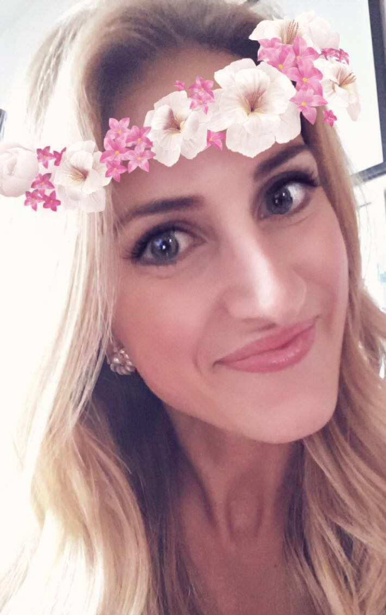
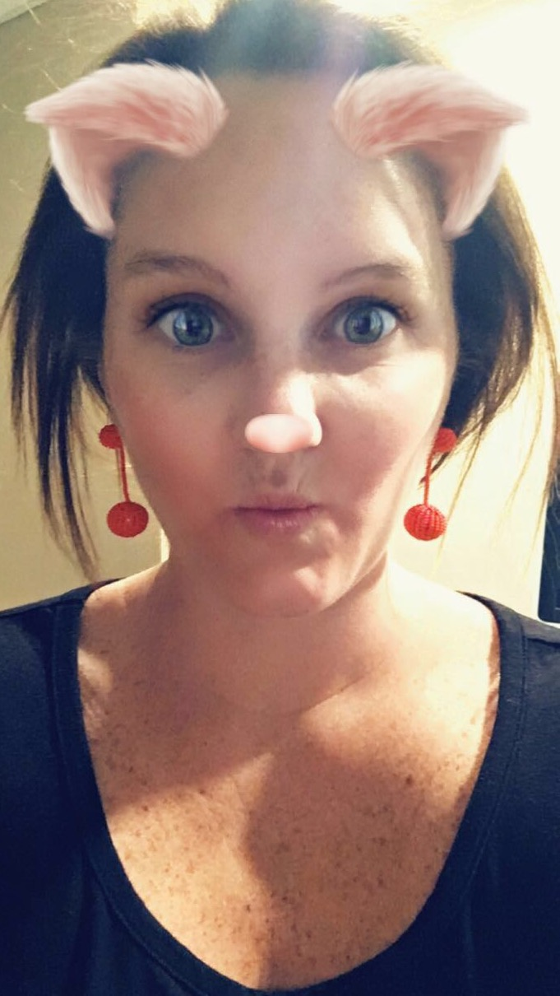
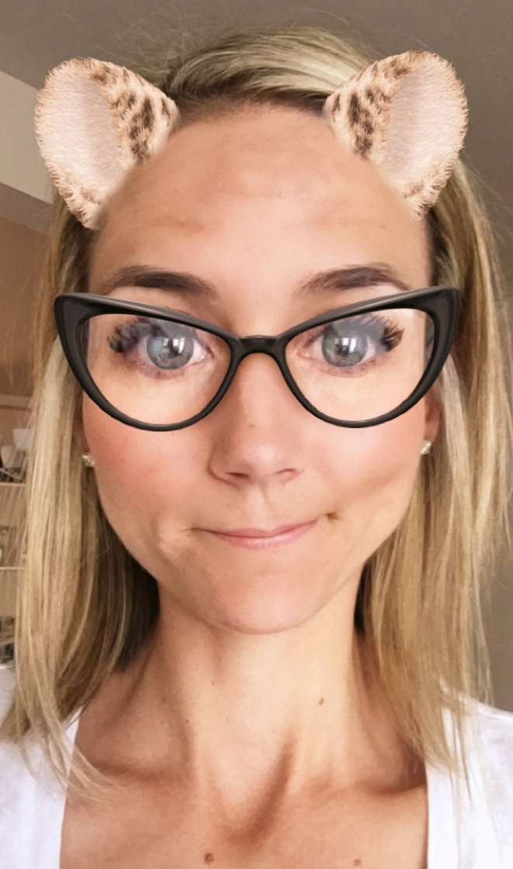
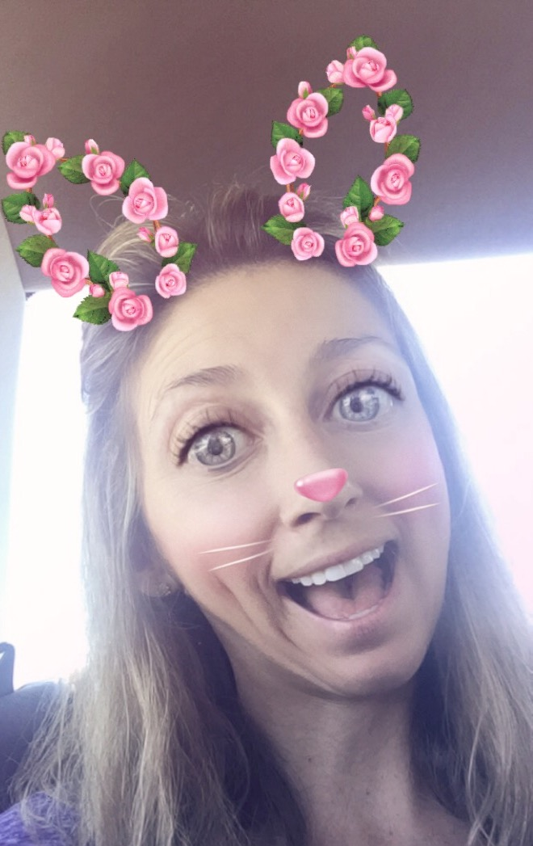
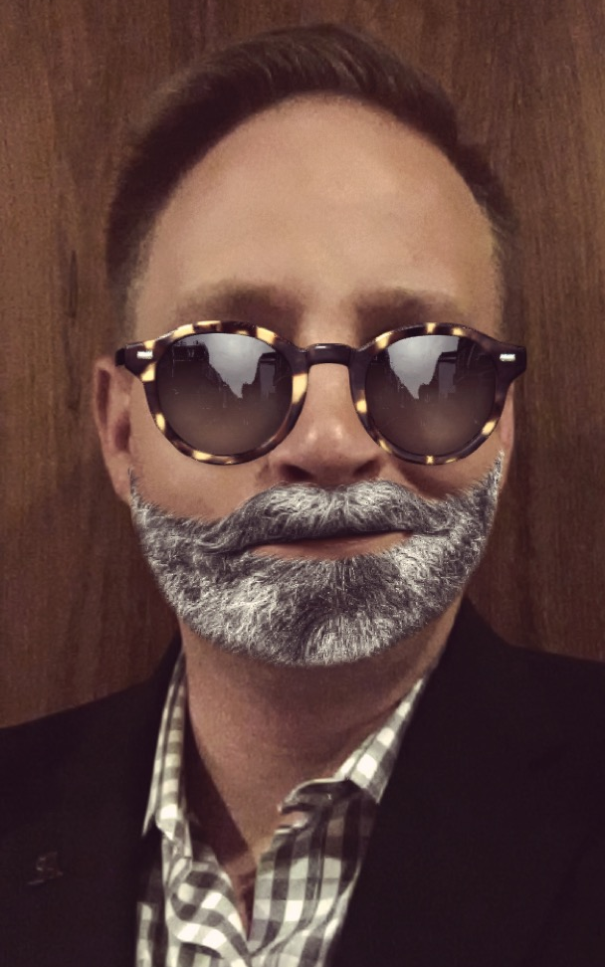
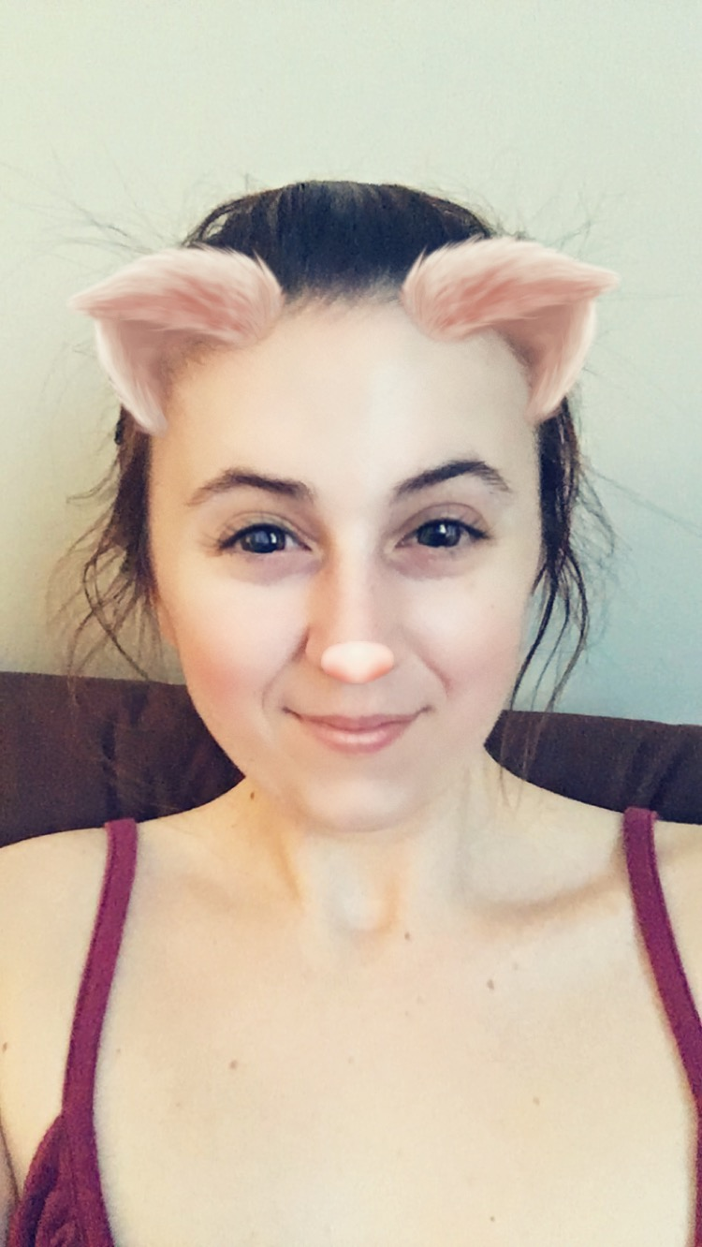
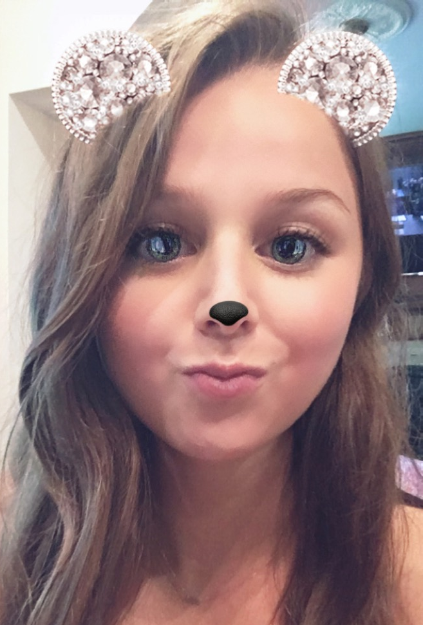
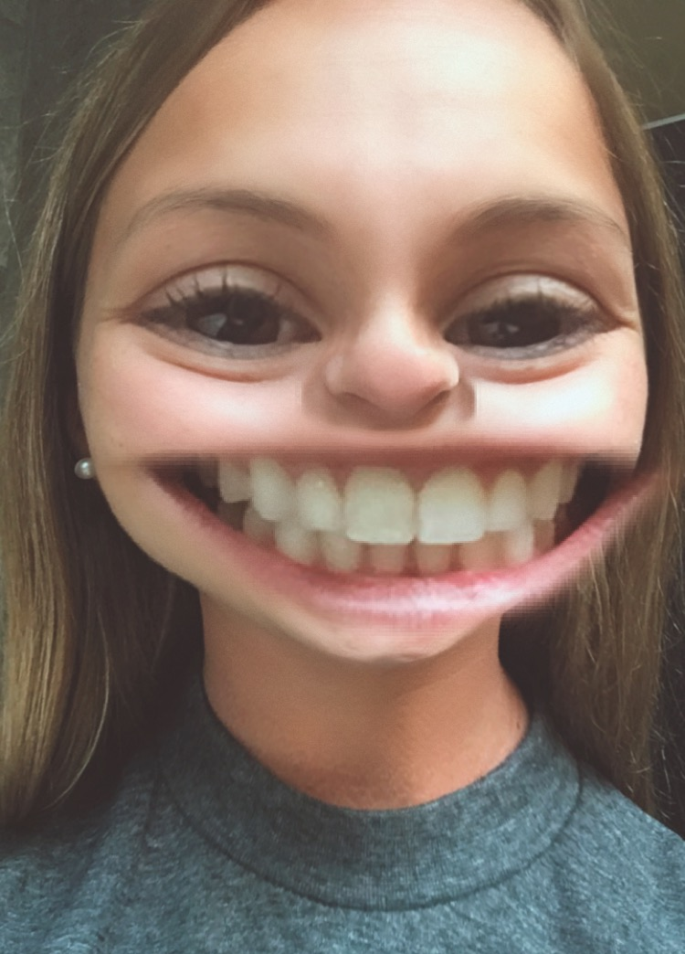
Next Gen Advisory Board 2017
HELP! I’m surrounded by beautiful women!
Diana Bittner (Chair), Christine Iovaldi (Vice Chair), Makenzie Tracy (Secretary), Natalie Tracy, Nikki Tracy, Jenny Capestrain, Ellie Stamerjohn and Kevin Bird

Slide 11
NGAB Update
Mission Statement: The Next Generation Advisory Board exists to cultivate an understanding of philanthropy and build leadership skills in the next generations. The board will actively listen to all generations offering opportunities, education and support to fulfill the Tracy Family Foundation’s vision for the family.
  Special Impact Grant 2016-2017
    Annual Budget: $50,000
    2016 SIG Focus Area: Elderly and Mental Health
    Awarded Grantees: Search and Care in New York, NY and Bessie’s Hope in Denver, CO and Great Circle, St. Louis MO
    2017 SIG Focus Area: Families of Children with Special Needs/Disabilities
      # of 3G Organizations Submitted: 5
Notes:
Diana

Slide 12
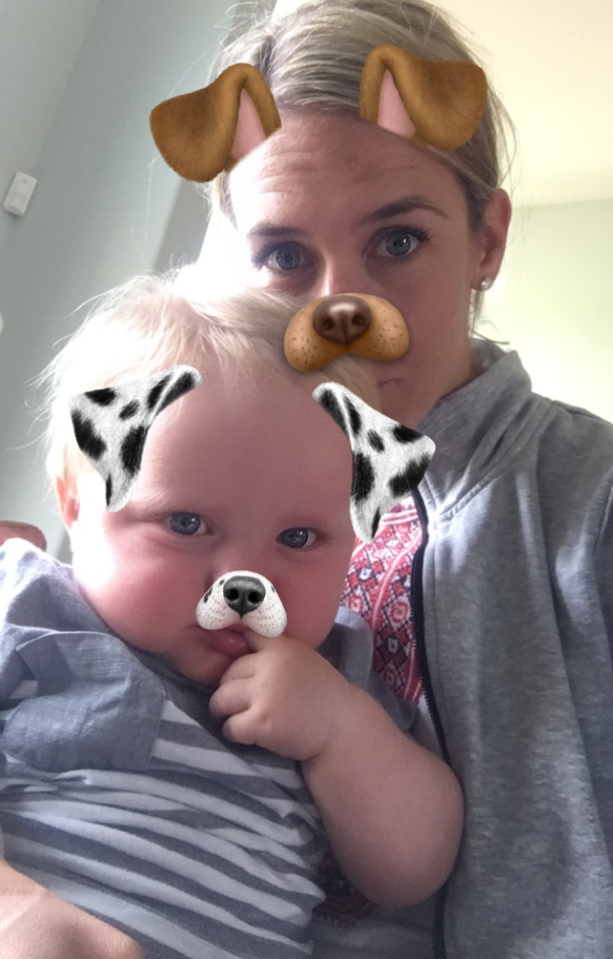
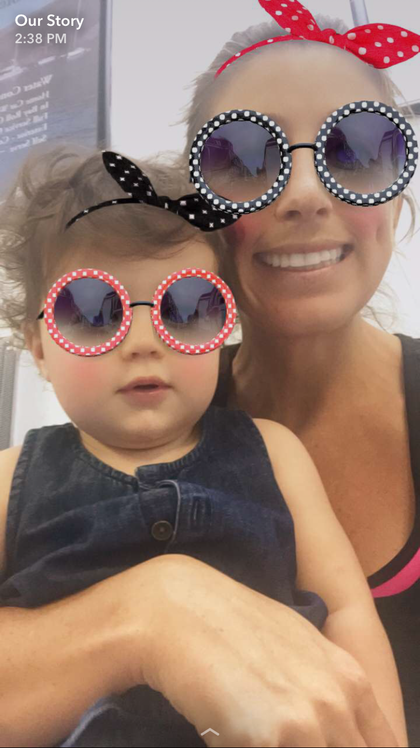
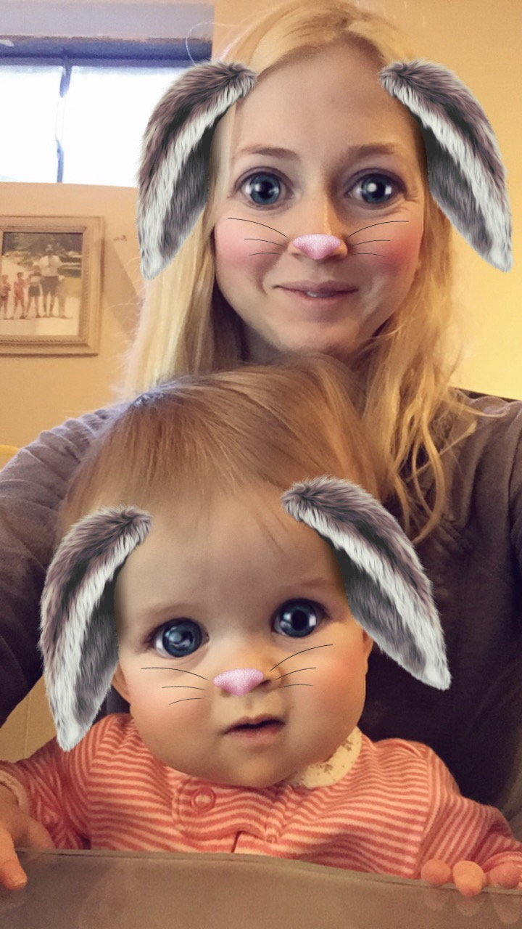
3G Grant Program Opportunities
Next Generation Grant Program
  3G/4Gs ages 5-30 are eligible
  Age 5-17 = $1,000 to give
  Age 18-30 = $3,000 to give
  Volunteer hours = extra funding
  3G Participation in 2016: 37 out of 44 Road to 100% participation!!
Matching Grant Program
  3Gs & 4Gs age 16 and older are eligible
  $50 minimum, TFF will match personal donation at 1:1, 2:1, or 3:1
  3G Participation in 2016: 16 out of 51
Road to 100% participation!!
Formal Funding Grant Program
  Family Invitation Grant Program
  3Gs age 30 and older are eligible
  3G Participation in 2016: 6 out of 19
Road to 100% participation!!
Questions?!
  All Grant Programs must be in keeping with the TFF Mission Statement and the values of
  Robert & Dorothy Tracy.
Notes:
Kenzie and Natalie to speak
Christine to ask a question on Family Invitation Grant to lead into Teachable Moment #1

Slide 13
Teachable Moment #1
Family Invitation Grants
What is it? An invitation to apply for a Formal Funding Grant from TFF
Who can I invite? A 501c3 organization within 50 mi. of where you live
Who is eligible? 2G and 3G Tracy Family Members age 30 and older whose primary residence are not located in the Illinois counties of Adams, Brown, Cass, Greene, Hancock, McDonough, Morgan, Pike, Schuyler, or Scott.
Are there any requirements? YES! So glad you asked!
  Just like the 3G Grant, you can only invite one organization per year
  The grant request must fall within the TFF Focus Areas: Education, Leadership, or Youth & Families
  A site visit is required, unless TFF has funded the organization in the past or the grant request is 5K
What is the maximum amount the invited organization can apply for?
  Age 30-39: $5000/year, Age 40 and older: $15,000/year
Can I invite the same organization year after year? Yes
What is the process? Submit Organization Name and Project to Aunt Jean requesting confirmation that this is a qualifying organization and the request is within keeping of the required Focus Areas. Then, if approved, extend invitation to Organization.
What is the deadline to apply? Eligible family members need to submit a Request to Invite to Aunt Jean by April 1, Aug. 1, or Dec. 1. The process to invite an organization to apply for funding needs to begin at least 4 months prior to the preferred review month (March, July, or November).
Notes:
Kenzie and Natalie

Slide 14
Teachable Moment #2
Site Visits
Led by: Gracie and Katelyn Schmidt
What questions should I ask on a Site Visit?
  The WHO?!
    Who is your organization?
    Who do you help?
  The WHAT?!
    What do you do for others?
    What programs do you have?
  The WHERE?!
    What geographic areas do you serve?
    Do you have any other locations in the U.S?
  The WHY?!
    Why does the organization exist? Ask about the history and who started it.
  HOW CAN I HELP?!
    What are your funding needs?
    If not me, then who? What are you main funding sources?
Don’t forget to pick up a business card and brochure!
Notes:
Gracie and Katelyn with Christine as the lead

Slide 15
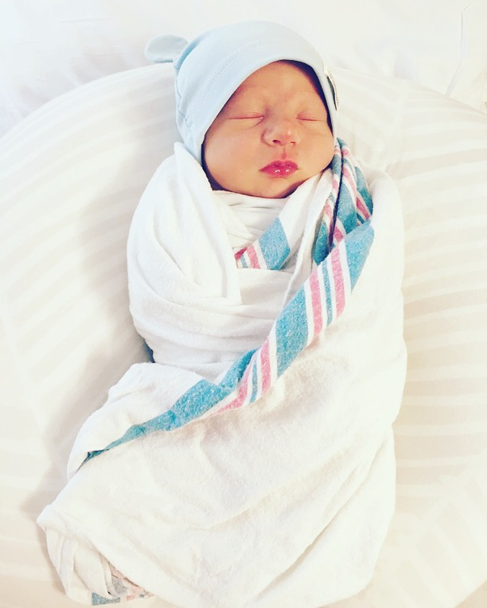
Our Growing Numbers
as of 6/21/17
Our newest 4G additions! Baby Bobby, Evelyn and Sophie!
Third Generation
  59 3Gs (47 3G descendants and 12 3G in-laws)
    30 years of age and older – 20
    Out of College Age – 27
    In College Age – 4
    High School – 3
    Grade School – 5
Fourth Generation
    18 4Gs (including the pregnant moms)
      Newborn to 6 years old
Notes:
Christine

Slide 16
Look what the future holds!
Year | 2G’s | 3G’s | 4G’s | Total
1997 | 24 | 38 | 0 | 62
2012 | 24 | 51 | 3 | 78
2015 | 24 | 55 | 8 | 87
2016 | 24 | 59 | 15 | 96
2026 Estimate | 24 | 84 | 43 | 149
10 Years from now our family will have nearly doubled in size!! WOW!
Notes:
Emphasis on Family Engagement
create and engage in opportunities to get together
maintain ozark reunion
One way we strive for fam engagement is volunteer activity

Slide 17
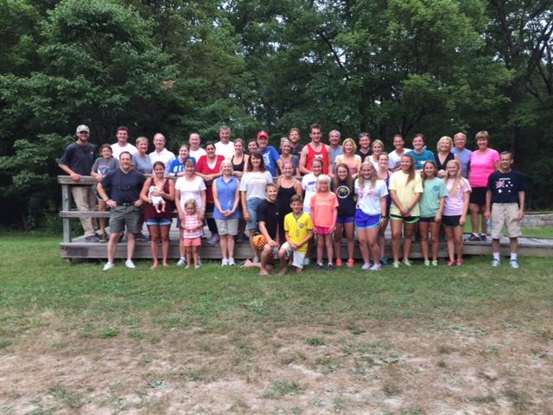
Tracy Family Outreach
2016 Activity: Wonderland Camp
  44 Family Members (2Gs, 3Gs, and 4Gs)
2017 Activity: On-site Family Service Activities at RT’s Cove
  When: June 30 - July 7
  Where: Clubhouse
  What: Osage Beach Elementary collections, Socks of Love and Operation Gratitude
Notes:
Tried a variety of different activities
Food panty, Wonderland Camp, in your own communities
Received everyones feedback from last year
this year we are doing in house, 3 different activites

Slide 18
NG and MG Review/Voting
One Minute Introduction of your Nonprofit
Notes:
Nikki and Ellie to handle voting

Slide 19
Introduction
Name of the Organization
What do they do?
Where did your money go?

Slide 20
Next Generation Grants
Global Foodbanking Network, Evo3 Foundation – Alex Tracy
Cheerful Home – Ali Tracy
Teaching Drum Outdoor School – Amelia George
Altus Math – Angie Tracy
Wonderland Camp – Ava Terwelp
Quincy Notre Dame – Ben Tracy
Global Foodbanking Network, Action Brown County – Brian Buckley
St. Louis Crisis Nursery – Christine Iovaldi
Big Brother, Big Sisters of Greater Kansas City – Chris Stamerjohn
Boys & Girls Club of Alton – Dan Iovaldi
Coalition for the Homeless – Diana Tracy
Ducks Unlimited – Drew Stamerjohn
Public Interest Law Initiative – Liz Tracy
Le Bonheur Children’s Hospital – Ellie Stamerjohn
Big Brothers, Big Sisters – Grace Schmidt
BJC Home Care Services – Hannah Tracy
Embarc – Jaclyn Tracy
Endangered Wolf Center – Jake Schmidt
Cheerful Home – Jenna Tracy
2016 Ozark Meeting Next Gen Winner: Diana Bittner
$3,000 for Edible Schoolyard in NYC

Slide 21
Next Generation Grants
The James Project – Jenny Capestrain
Humane Society of Southern Arizona, Smiling Dog Rescue – Julia Capestrain
Our Little Haven – Katelyn Schmidt
Almost Home Kids – Kelsey Tracy
Cheerful Home – Kristin Tracy
Ducks Unlimited – Luke Stamerjohn
The Women’s Lunch Place – Maggie Sullivan
IamMORE Foundation – Matt Tracy
Family Promise of North Fulton/DeKalb – Megan Costigan
Children’s Miracle Network – Micaela Tracy
FOCUS St. Louis – Mike Tracy
Life Styles, Inc. – Nikki Tracy
Cheerful Home – Liv Tracy
Cheerful Home – Sam Tracy
Family-to-Family – Sam Sullivan
Boston College – Teresa Sullivan
The James Project – Tim Capestrain
St. Clement Church – Zach Tracy
Total Next Gen Grants
2015 : $79,500
2016: $105,500

Slide 22
3G Matching Grants
Arthritis Foundation – Angie Tracy
Birthright Counseling, St. Louis – Annie Tracy
Our Lady of Lourdes – Ben Tracy
Amigos for Christ – Christine Iovaldi
Global Foodbanking Network, Coalition for the Homeless, The Bridge Fund of New York, Bonnie Youth Club, Search and Care – Diana Bittner
Land of Lincoln Legal Assistance Fund, United Way of Central Illinois – Liz Tracy
Safe Connections, Truckers Against Trafficking, Operations Food Search – Erica Buckley
Global Foodbanking Network, Clothes to Kids of Denver, Wings of Hope, Senior Assistance Center, Whiz Kids Tutoring – Erin Bird
2016 Ozark Meeting Matching Grant Winner: Kenzie Tracy
$3,000 for Hands Up for the Children in Denver
Notes:
*Organizations in Blue: 3G pick to speak to and submit for voting during meeting

Slide 23
3G Matching Grants
The Victim Center – John Buckley
Almost Home Kids – Kelsey Tracy
Global Foodbanking Network, Bessie’s Hope, Denver Kids, Children’s Hospital Colorado Foundation, Little People of America – Kevin Bird
Global Foodbanking Network, Lift for Life Academy, SOS Outreach, National Sports Center for the Disabled, Steve’s Club, Sacred Heart House of Denver – Lauren Tracy
Global Foodbanking Network, A Precious Child, Warren Village, Children’s Outreach Project – Kenzie Tracy
Global Foodbanking Network – Rachel Hedgecorth
Global Foodbanking Network, Big Idea Project, James Resource Network, Tennyson Center for Children, Big Brothers, Big Sisters of Colorado, Parent Possible – Ryan Tracy
Water Legacy – Steven George
Total Matching Grants
2015: $21,580
2016: $32,675

