Slide 1
August 2, 2021 Annual Next Gen Ozark Meeting
Notes:
Presenter: Kelsey Cope

Slide 2
Agenda
Group Photo 4G Learning to Give Activity TFF / Brown County Projects NGAB Special Impact Grant Servember Next Gen & Matching Grant Review/Voting
Notes:
Presenter: Kelsey Cope

Slide 3
Group Photo - All 3Gs and 4Gs - NGAB
Notes:
Presenter: Kelsey Cope

Slide 4
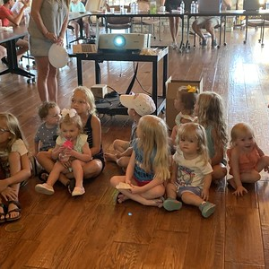
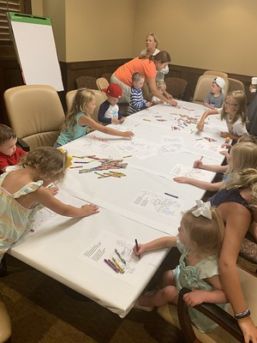
4G Learning to Give Activity Boardroom
Notes:
Presenter: Kelsey Cope
- Dismiss 4Gs to the boardroom and 2Gs who are there to help Linda

Slide 5
TFF / Brown County Projects
Notes:
Presenter: Jean

Slide 6
Brown County Projects
Bike Trails Brown County Early Learning Center Brown County Public Library IL Transportation Enhancement Program grant Welcome Signs Building Wall Mural Dorothy Tracy Estate Gift
Notes:
Presenter: Jean

Slide 7
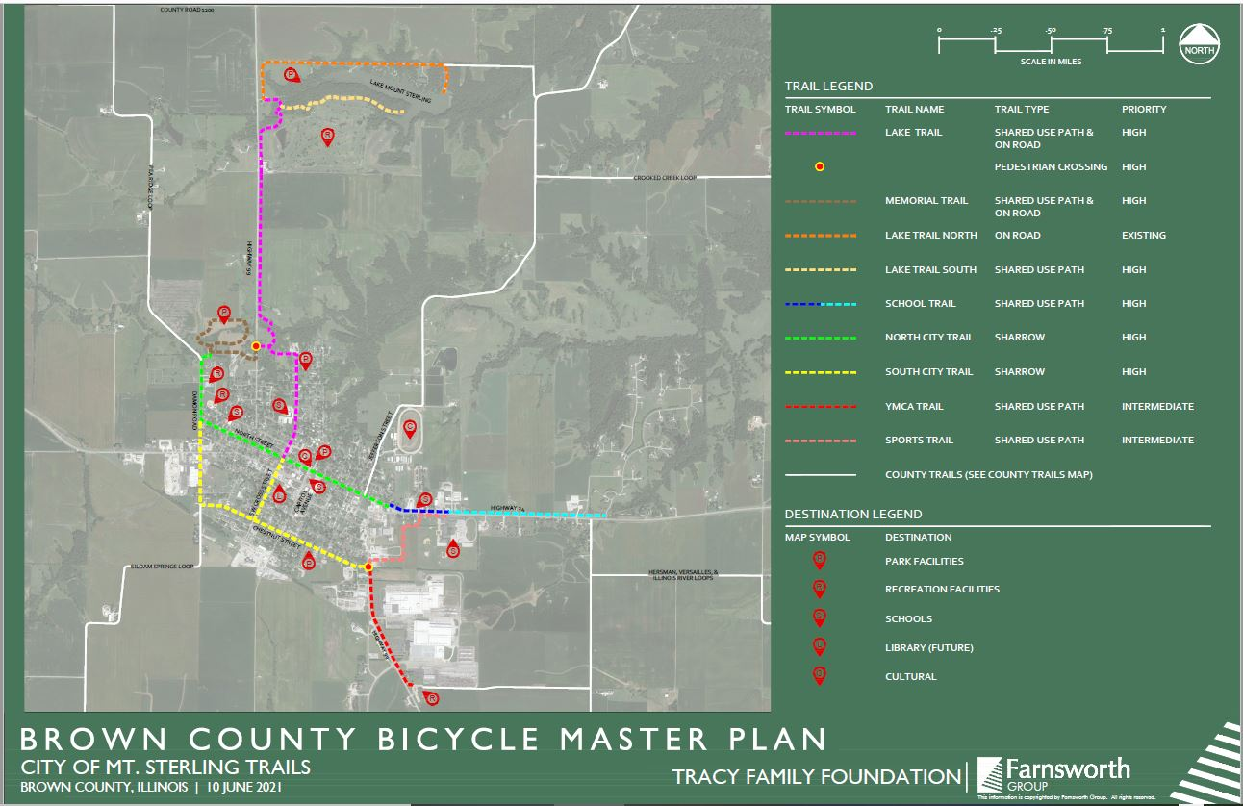
Bike Trails
Notes:
Presenter: Jean

Slide 8
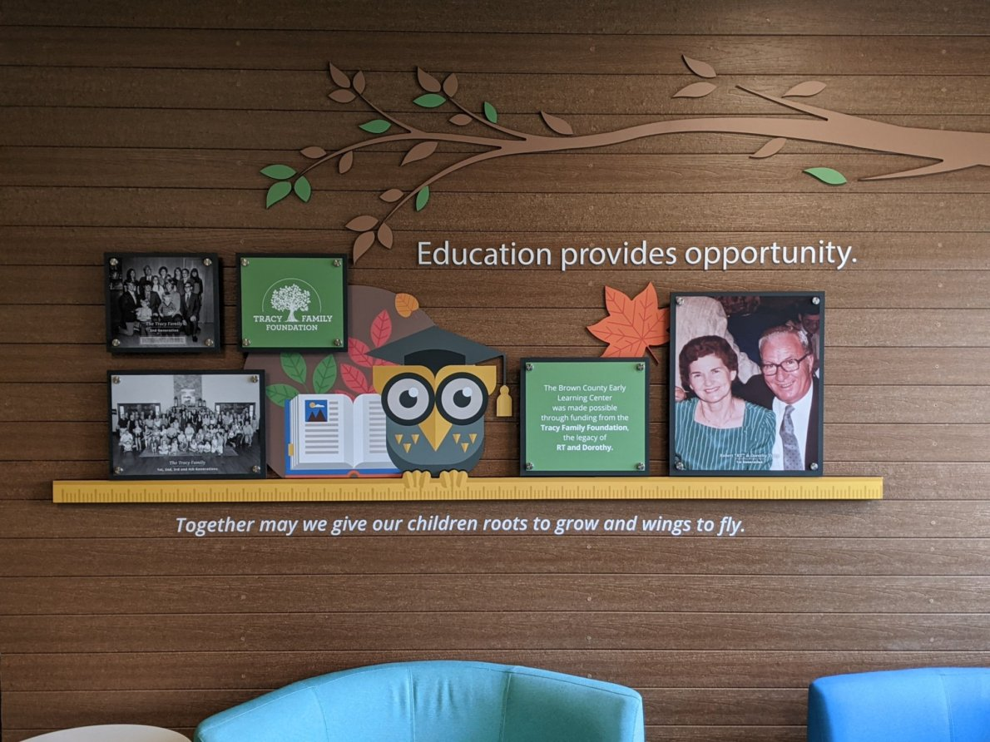
BC Early Learning Center
Enrollment as of 6/28/2021 Parent and Staff Survey Parent testimonial
Age | Number of Kids
Infants | 12
Toddlers | 10
2-Years | 11
Pre-K | 14
Total Enrollment | 47
Total Kids on Wait List | 9
Tribute Wall to RT and Dorothy
Notes:
Presenter: Jean
Survey – parents had very positive comments about the ELC
TFF Contribution - $300k budgeted. Y provides quarterly P&L statements.

Slide 9
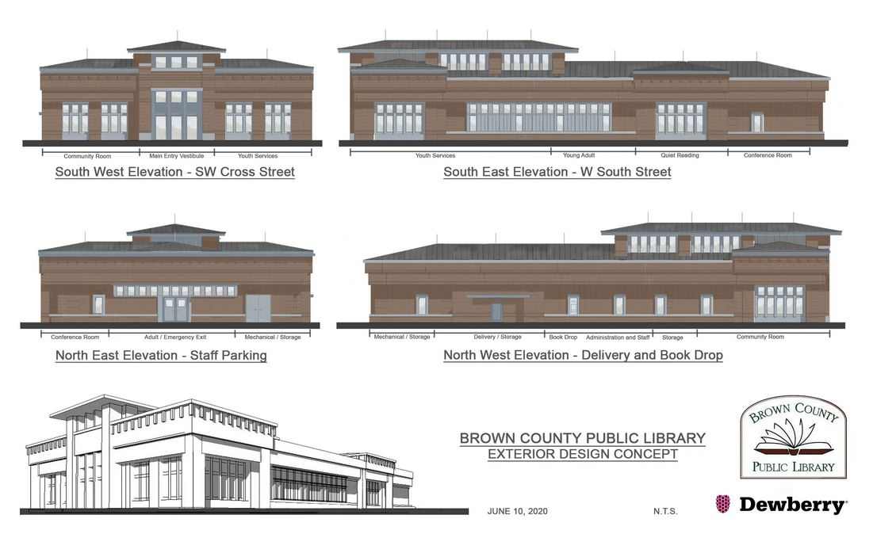
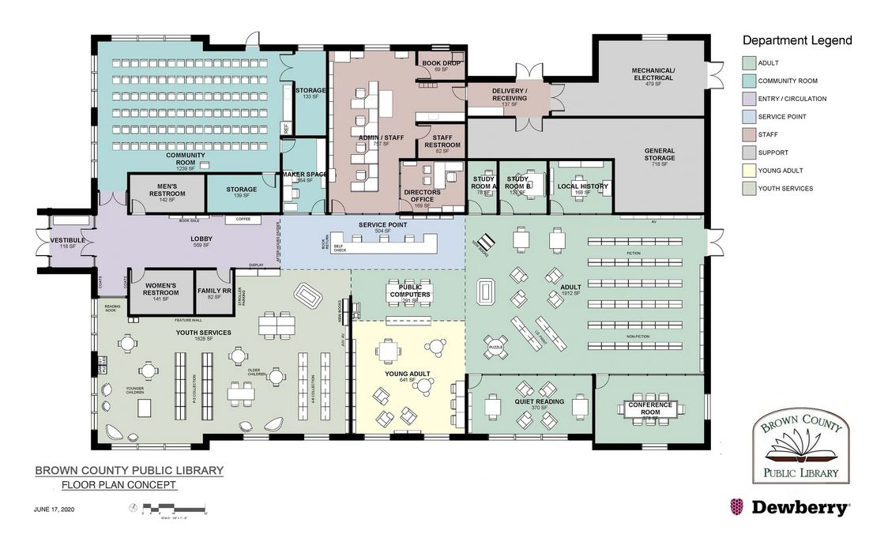
Brown County Public Library
SW Cross Street, just off Main St. Projected cost $5.4 million Construction will begin in early 2022 (contingent on state grant) Meet Me at the Library
Notes:
Presenter: Jean
- Cost Breakdown: $2M from anonymous donor, $500k raised, and $2.25M grant request from the state which they should know by end of August if they get that state funding. Variance if state grant is received, $650k. Variance without state grant is $2.5M.
- The library hired Table Sixteen to create short promotional videos for their fundraising campaign. They paid for these videos with a grant received from TFF.

Slide 10
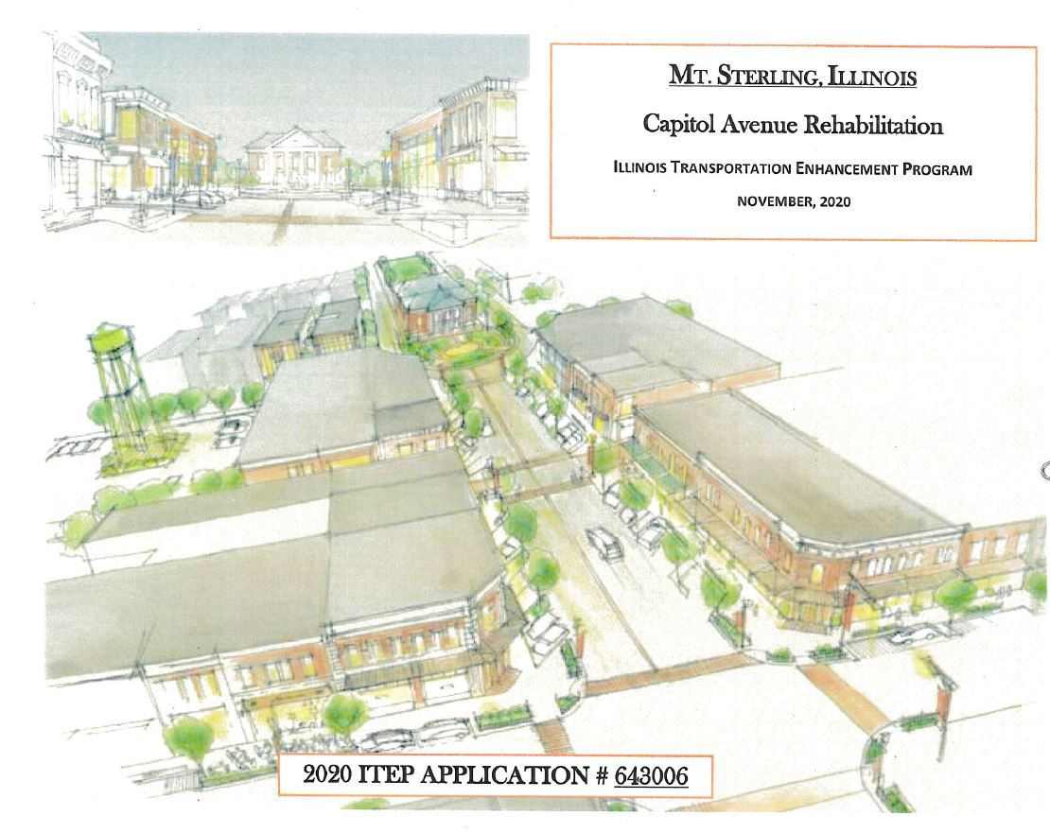
Illinois Transportation Enhancement
Program (ITEP) grant
IL Dept. of Transportation awarded grants totaling $105.9 million throughout the state Mt. Sterling received $1.379 million Work planned to start in Spring 2022
Notes:
Presenter: Jean

Slide 11
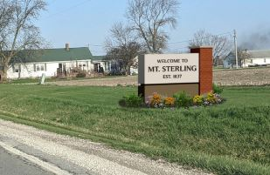
Welcome to Mt. Sterling Signs
5 locations entering/exiting Mt. Sterling - Highway 24 W and E - Highway 99 N and S - Highway 107 S
Notes:
Presenter: Jean

Slide 12
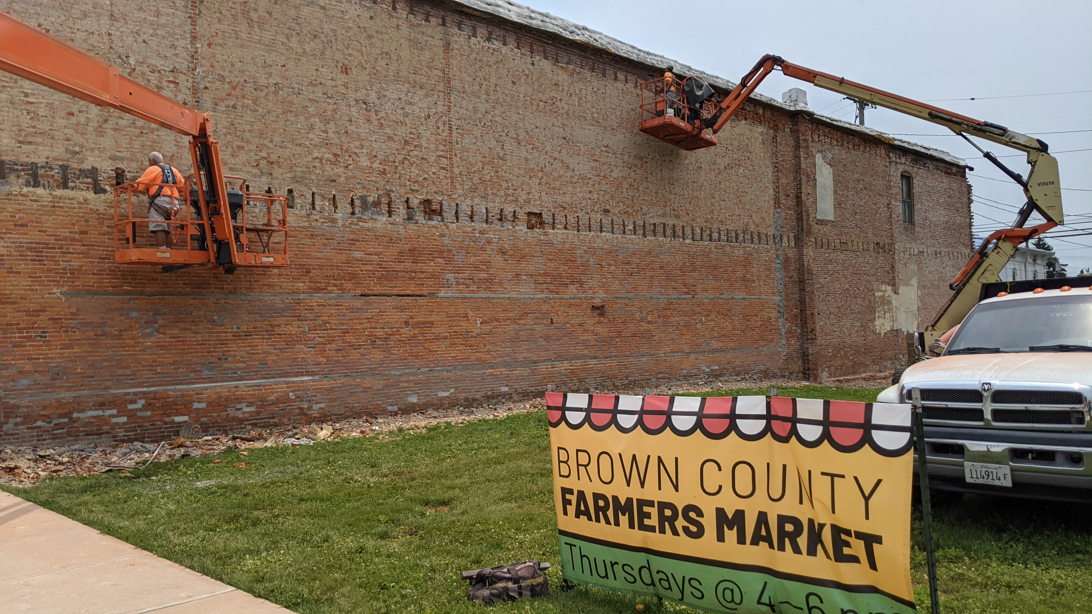
Building Wall Mural
Location: next to Veteran’s Memorial on Main Street Artist and design Timeline
Notes:
Presenter: Jean
Artist is narrowed down to the top 3. Once artist is selected, then the design will be finalized
Timeline – on track to start painting in early fall?

Slide 13
Dorothy Tracy Estate Gift
Organization | Project
Holy Family/St. Mary School | Facility Improvements
Mt. Sterling Park District | Joel Oliver Memorial Swimming Pool Improvements
Brown County Public Library | New Library Construction
Mt. Sterling Park District, Brown County, et al. | Trails
City of Mt. Sterling, Brown County, et al. | Fresh flowers, landscaping
Notes:
Presenter: Jean

Slide 14
Next Generation Advisory Board
Notes:
Presenter: Kelsey Cope

Slide 15
2021 NGAB Update
Next Generation Advisory Board (NGAB)
Board Members: Kelsey Cope (Chair), Jake Schlater (Vice-Chair), Kelsey Breathitt Tracy (Secretary), Arianna Buckley, Jake Schmidt, Natalie Tracy, and Megan Costigan (TFF Advisor)
Goal: To develop a philanthropic spirit among Next Gen family members; create individual and multi-generational leadership development and opportunities; help prepare Next Gen family members to serve on TFF Board, and provide support to the TFF Board in carrying out its mission
Notes:
Presenter: Kelsey Cope

Slide 16
Cybergrants Portal
ACCESSING THE PORTAL: Go to the TFF website and click “Members – Tracy Family Members.” When new page opens, click “Access Tracy Family Grant Portal”.
LOGIN: Email Kim your preferred username if you haven’t already. Your username can be anything except an email address.
Initial password: tracyfamily
FAMILY MEMBERS AGE 16 AND UP:
Single Family Members: your own login credentials. Your available request amount will start at $60,000. The available amount decreases as you submit Matching Grant requests.
Married Family Members: you have the option of having a joint login with your spouse or a single login.
Single login: available request amount will start at $60,000
Joint login: available request amount will start at $120,000
Notes:
Presenter: Kelsey Cope
- Password - you will need to change this after logging in the first time
Login – reach out to Kim with questions. And, if you haven’t told Kim if you/your spouse want a single or joint account, please let her know.
Megan also has the login info if anyone has questions today.
All family grants are submitted through the Cybergrants Portal.

Slide 17
Next Gen Grant Program
Eligibility: 3Gs & 4Gs aged 5-30 TFF Dollars 2020 Participation
Age | TFF Dollars
5-10 | $1,000
11-17 | $2,000
18-24 | $3,000
25-30 | $5,000
2021 Participation
Generation | % Participation | TFF $ Granted
3G | 97% | $127,000
4G | 100% | $8,000
Notes:
Presenter: Kelsey Cope

Slide 18
Matching Grant Program
Eligibility: 3Gs ages 16 and older Min. Requirement of Personal Dollars: $50 TFF will match: *Up to $60,000 per year *Ages 16-30: 5:1 *Ages 31-39: 4:1 *Ages 40+: 3:1 *All ages can choose a: 3:1, 2:1 or 1:1 2020 3G Participation
2021 Participation
% Participation | Total Family Contributions | Total TFF Contributions
75% | $94,697 | $371,851
Notes:
Presenter: Kelsey Cope

Slide 19
Family Invitation Grant Program
Who is eligible? Family members 30 and older who live outside of the 10 counties in West Central Illinois How many invites can I submit per year? 1 How many TFF dollars can I request? *Ages 30-39: $10,000 per year *Ages 40 and older: $15,000 per year Does the grant request need to be in keeping with one of TFF’s focus areas? Yes Do I have to donate any personal dollars? No Next Invitation Deadline: September 1 First Step in Process: Tracy family member selects an organization and then must get approval from Dan to invite the organization to submit a Formal Grant Application.
Notes:
Presenter: Jake Schlater
- Emphasize this is one of the easiest grant programs. They could send Dan an email right now during the meeting! ☺

Slide 20
Family Invitation Grant Program, cont.
2020 3G Participation
% Participation | Total TFF Dollars Granted
79% | $265,000
2021 Participation
Notes:
Presenter: Jake Schlater

Slide 21
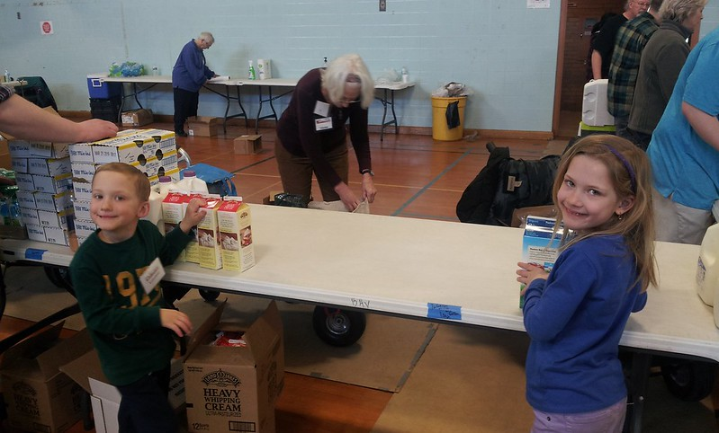
Volunteer Incentive Program
Eligibility: all Tracy family members age 5 and older Hours: can be accumulated over 2 years Dollars: can be awarded to up to 4 organizations How to submit: TFF grant portal
Year | Dollars Granted | Hours Volunteered | Family Members
2019 | $7,000 |  | Catherine Tracy, Annie Tracy
2020 | $17,000 | 120.5 | Genavive George, Galvin George, Amelia George, Steven George, Kristin Tracy, Liz Tracy
Notes:
Presenter: Ari Buckley

Slide 22
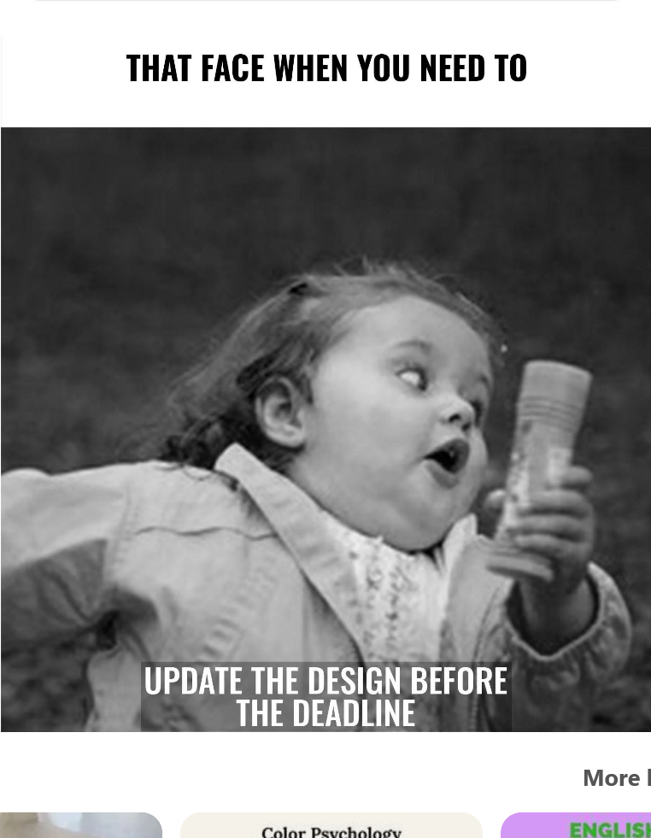
Family Grant Program Upcoming Deadlines
September 1 Family Invitation Grant Program December 1 Next Gen, Matching and Volunteer Incentive Programs
Need Help or Have Questions?
Reach out to Megan Costigan
COMPLETE YOUR GRANTS BEFORE THE DEADLINE
Notes:
Presenter: Ari Buckley

Slide 23
NGAB Special Impact Grant
Notes:
Presenter: Kelsey Tracy

Slide 24
NGAB Special Impact Grant History
Grant Year | Focus Area | Budget | Approved Grant Dollars
2014 | Child Abuse, Prevention & Health | $20,000 | $20,000
2015 | Family Support | $25,000 | $25,000
2016 | Mental Health & Elderly | $50,000 | $50,000
2017 | Families of Children with Special Needs/Disabilities | $50,000 | $50,000
2018 | Children/Youth Affected by Mental Health | $100,000 | $100,000
2019 | Mental Health re: Drug Abuse | $100,000 | $100,000
2020 | Childhood Trauma | $100,000 | $100,000
2021 | Foster Care | $100,000
 | Total Dollars: | $545,000 | $445,000
Notes:
Presenter: Kelsey Tracy

Slide 25
NGAB Special Impact Grant 2020
Org Name | Project/Program | Grant | Location | Status
Child Abuse and Neglect Emergency Shelter dba Rainbow House | Rainbow House Technology Upgrades | $20,000 | Columbia, MO
Children’s Home Society of Missouri dba FamilyForward | Addressing Childhood Trauma: Better Insights. Better Outcomes. | $30,000 | St. Louis, MO | https://drive.google.com/file/d/1GzEhWppvYTYoFdkua7ajZMprdDsJwA3G/view?usp=sharing [drive.google.com]
Christian Social Services DBA Caritas Family Solutions | Virtual Reality Prolonged Exposure Therapy at St. John Bosco Children's Center | $25,000 | Belleville, IL | Equipment delivery & installation delayed to mid-August because of covid
Mary Lee’s House | Promoting Early Developmental Interventions Clinic | $25,000 | Tampa, FL | https://s3.us-east-2.amazonaws.com/memoryfox/3twxusc2/webencode.mp4
Notes:
Presenter: Kelsey Tracy

Slide 26
NGAB Special Impact Grant 2021
Budget: $100,000 Focus Area: Foster Care Organizations
Organization | Location
Marygrove | St. Louis, MO
Good Shepard | St. Louis, MO
Voices for Children | Tampa, FL
SOS Children’s Villages | Chicago, IL
Mount Saint Vincent | Denver, CO
Notes:
Presenter: Jake Schmidt

Slide 27
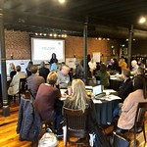
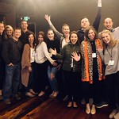
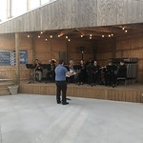
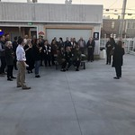
2021 TFF Impact Retreat
Date: Saturday, October 2, 2021 Location: Mt. Sterling
Notes:
Presenter: Jake Schmidt
Shareholder Meeting: Thursday dinner, Friday meeting
TFF Impact Retreat: Friday dinner, Saturday meeting
Chris & Melanie Engagement Party: Saturday night in Quincy

Slide 28
Servember
Purpose: to cultivate a philanthropic spirit in the family. We believe one of the ways to do that is to encourage the family to volunteer and serve others. What & When: volunteer in your community throughout the month of November 2021: Communication from Megan coming soon Participation History
Year | Tracy Family Members (By Heads) | Participation (By Heads) | Participation (By %)
2018 | 110 | 71 | 65%
2019 | 118 | 80 | 67%
2020 | 124 | 103 | 83%
Notes:
Presenter: Jake Schmidt
2021 Servember – it will be similar to 2020. Megan will send communication to the family in early fall.

Slide 29
Do you want to serve on the Next Gen Advisory Board? Reach out to any NGAB member or Megan.
Notes:
Presenter: Kelsey Tracy, Jake Schlater (any NGAB members can share here)
Briefly tell the 3Gs what you have liked, learned, etc. about serving on NGAB.
Megan will be working on the 2022 NGAB member list this fall. Reach out to her if you are interested.
All NGAB members and Megan can answer any questions about the work, commitment level, etc.

Slide 30
Next Gen & Matching Grant Reviews and Voting
Notes:
Presenter: Kelsey Cope / Ari Buckley

Slide 31
2020 Next Gen & Matching Grants
Total Next Gen Grants: $135,000
Total Matching Grants:
$94,697 (personal $) + $371,851 (TFF $) = $466,548
2020 Matching Grant Winner of $3,000:
Laughing Bear Bakery
St. Louis, MO
(Christine Iovaldi)
2020 Next Gen Grant Winner of $3,000:
National Conference for Community and Justice of Metro St. Louis
(Mike Tracy)
Notes:
Presenter: Kelsey Cope / Ari Buckley

Slide 32
Next Gen & Matching Grant Reviews
Name of Organization What do they do? Why did you choose this organization?
Notes:
Presenter: Ari Buckley

Slide 33
Questions?
Thank You!
Notes:
Presenter: Ari Buckley / All can answer questions

